Slide 1
Hobbies and Free Time
Lesson 5: Writing

Slide 2
Notes for the Educator
This lesson is pegged directly to Learning Outcomes WR5.9 I can write a paragraph appropriately for an audience and with a purpose.
Teachers are to refer to the Scheme of Work where each lesson is explained in more detail.
Effects are included to make the presentation more interactive. Please present the PowerPoint in Slideshow mode.
Wherever possible we have included the use of online apps to enhance the teaching and learning experience.
The Notes section underneath the slides may contain some further points which can be developed during the lesson.
Teachers are encouraged to adapt this PowerPoint presentation to meet the learners’ language needs.
Audio files or links to websites may be included.
Tasks included in the PowerPoint presentation are also being shared as handouts.
For any comments, feedback or suggestions please email us at: marie-claire.camilleri@ilearn.edu.mt; urieth.attard@ilearn.edu.mt; mary.jude.camilleri@ilearn.edu.mt. You may also call the office on: 25983683.

Slide 3
I am learning how to fill a feedback form.
I can write my personal details accurately.
I can explain what I like and what I don’t like.
I can check my work, improve my writing and correct mistakes.

Slide 4
During the Summer holidays, you attended the Kids Summer Camp. Now that the Camp is over you need to fill out a feedback form to let the staff at the camp know what you think of the activities they prepared. Fill in the feedback form. Include all the correct details and information.
Notes:
Have learnerd try to identify the genre, the audience and the purpose.

Slide 5
form
G
A
The staff at the camp
P
To describe your experience

Slide 6
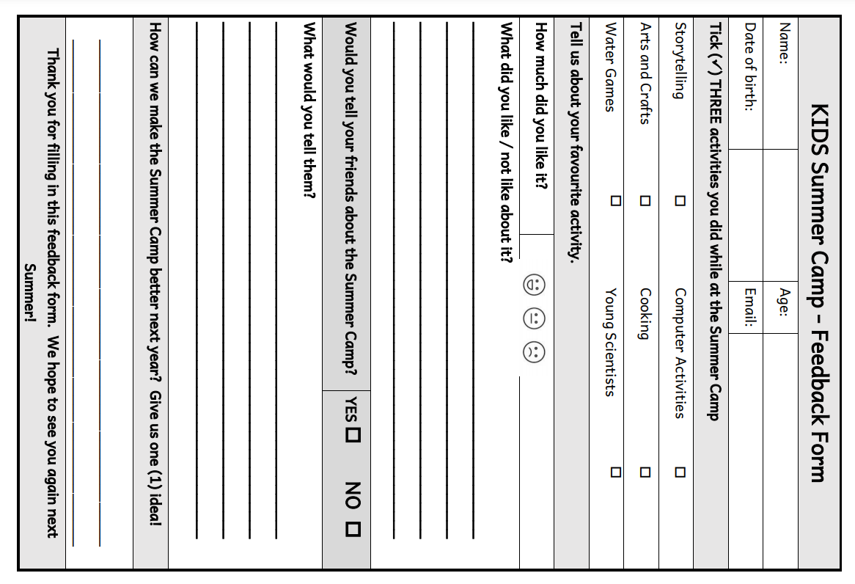
Feedback form
Sum up your summer camp experience
Say what you like and what you did not like
Give suggestions how the staff can improve their practice
Keep it brief and to the point
Be truthful

Slide 7
personal details
Tick only three activities.

Slide 8
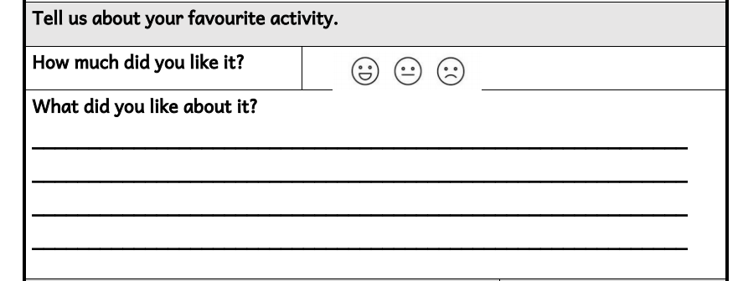
Favourite activity (choose one from the three ticked above).
You need to show whether you liked it or not by choosing a smiley face.
Space to write what you liked most about this activity.
Ideas:
How often did you take part in this activity?
What made this activity your favourite?
What have you learnt from this activity?
How did the teacher make the activity fun/interesting?

Slide 9
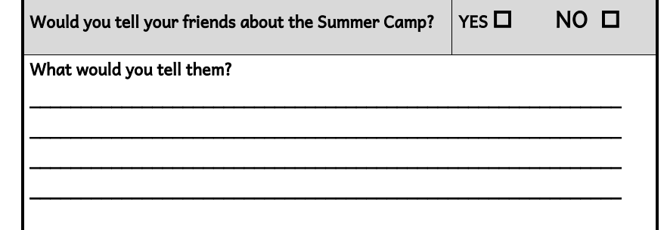
Tick YES or NO.
Your reply must match to YES or NO above.
Ideas:
Encourage them to attend next year
Mention some of the activities you did
Different activities offered which appeal to your friends’ interests

Slide 10
Offer a suggestion.
Ideas:
Smaller groups
Include some other activities that you enjoy
Organise a talent show at the end…

Slide 11
8
Abby
25-5-2013
abby.galea@ilearn.edu.mt

Slide 12
Notes:
Here we need to tick three of the activities we did while at the summer camp.

Slide 13
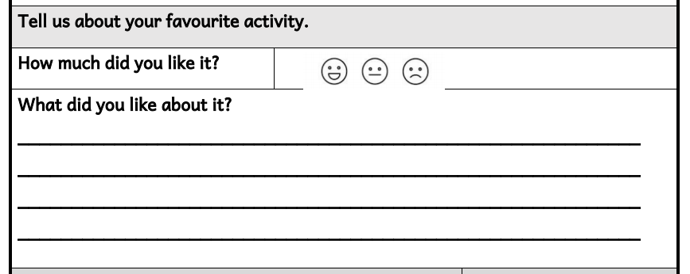
What made this activity your favourite?
What have you learnt from taking part in this activity?
How did the teacher make the activity fun /interesting?
How often did you do this activity?
. We
My favourite activity was Cooking.
prepared some healthy recipes such as
I learnt
fruit kebabs and chicken wraps.
a lot about keeping safe in the kitchen.

Slide 14
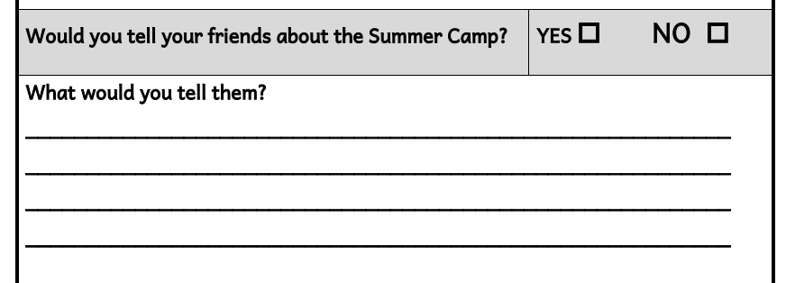
Mention some of the activities offered
How does this programme appeal to the interests of your friend?
Encourage them to attend next year
I had a lovely time at the club.
We always
did exciting activities such as water games
and cooking.
The teachers were very
friendly and I hope to join the Kids
Club next Summer.
You should come, too!

Slide 15
Spend more time doing your favourite activity
Organising a talent show at the end.
Smaller groups
I think there should be a talent show at the end. :.
Everyone can have a turn to show what they are good at.
Notes:
Now, finally we need to give one idea how the staff can offer a better experience next year. Let’s think back to the ideas we discussed.
I’m going to write about the last idea…the idea of the talent show. So, I will can say… And that’s it, I have filled in all of my feedback form.

Slide 17
Thank you for using this resource. Check out our latest resources below.

