Slide 1
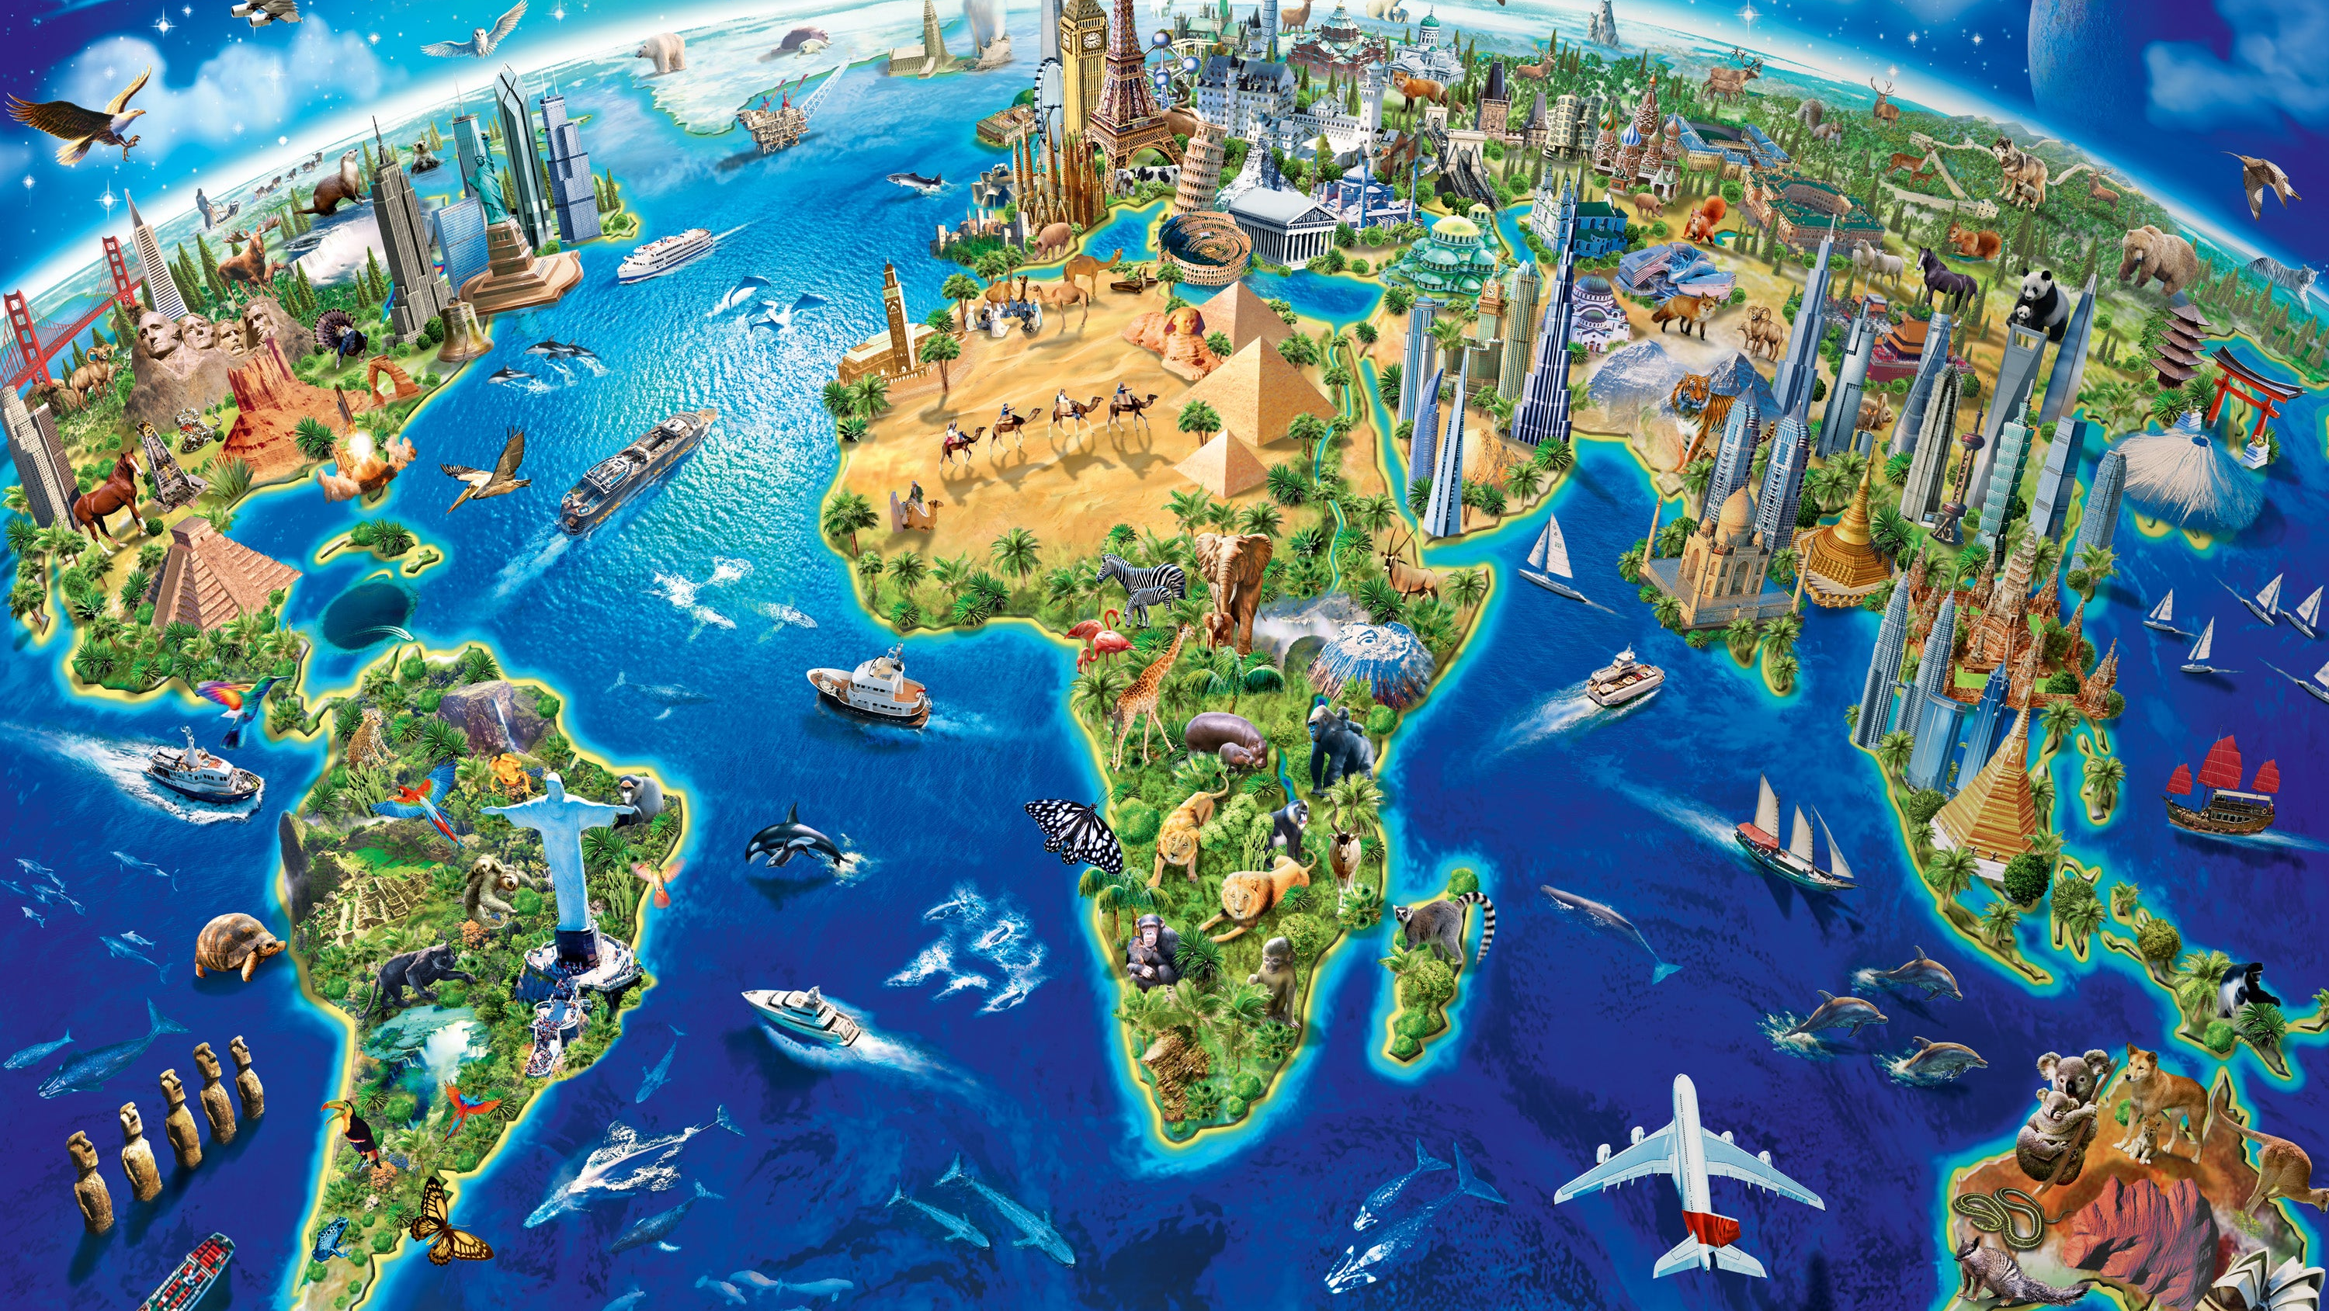
Cities and Landmarks
Lesson 5 - Writing

Slide 2
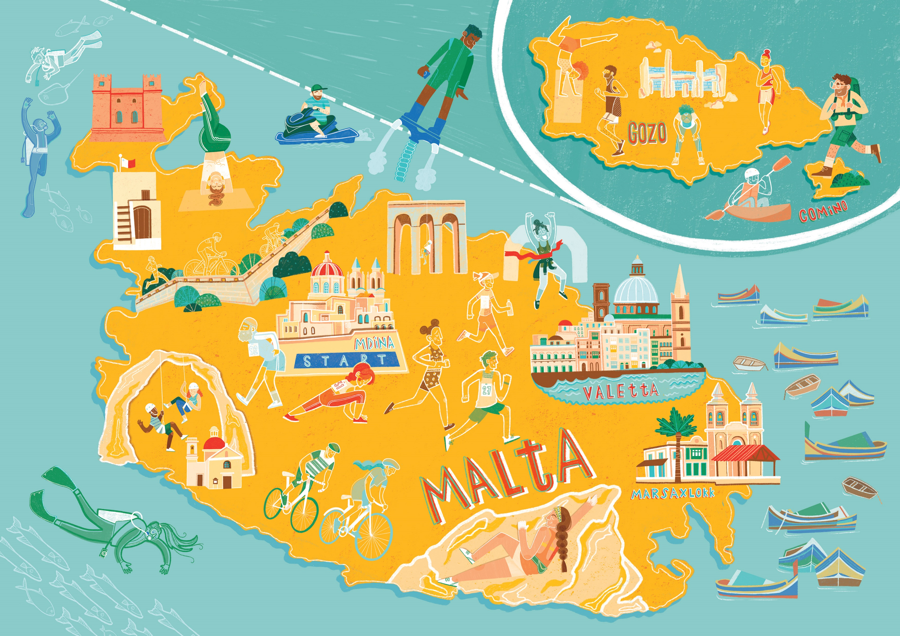

Slide 3
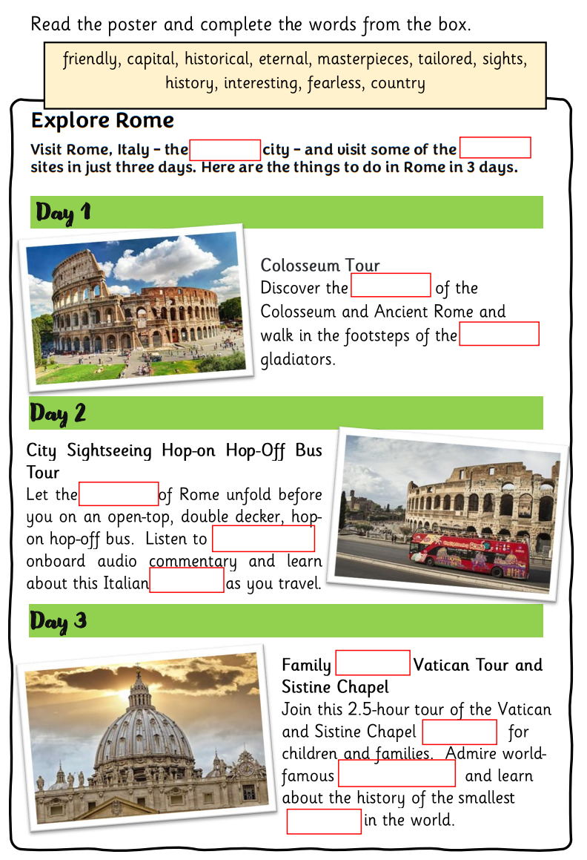
Look at the model text.

Slide 4
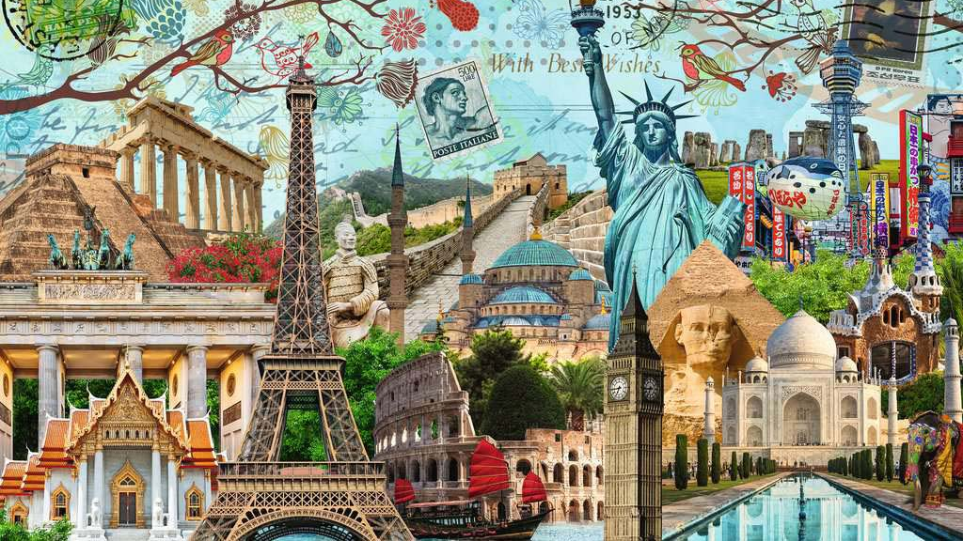
Your task is to plan and design a poster to encourage tourists to visits your favourite city.
Think about which landmarks they can see and what amazing activities they can do while in this city.
Read these ideas and then complete your planning sheet.

Slide 5
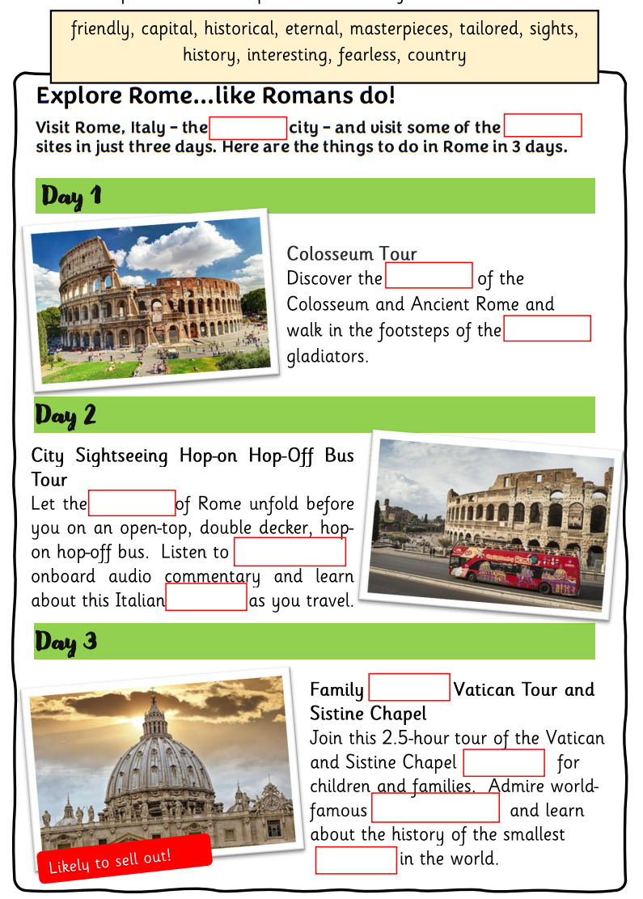
Choose three landmarks you would like to write about.

Slide 6
Choose a catchy name for your poster.

Slide 7
Focus on the reader – make them feel involved and that you want them to visit this city.
Use commands to tell your reader what to do – visit, listen, discover, etc.

Slide 8
Describe how wonderful everything will be. Use powerful phrases – eternal city, fearless gladiators….

Slide 9
Add a special offer or a bargain.

Slide 10
Repetition – you could repeat some of your words to make the reader want to visit this city.

Slide 11
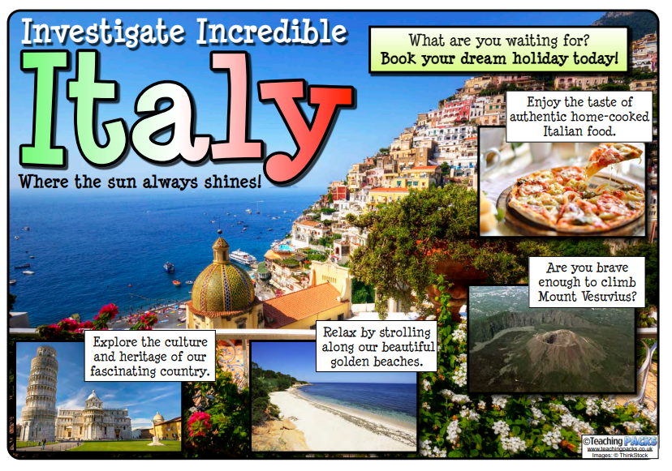

Slide 12
Looking at language
Use of the Imperative | Adjectives | Powerful phrases
Explore… Enjoy… Discover… Roam around… Stroll amid… Finish your tour… Experience for yourself… See… Marvel at Learn more… Admire… Visit… | beautiful fascinating ancient historical authentic traditional silent magical amazing glorious pleasant informative | Book your dream holiday today! What are you waiting for? Where the sun always shines. A true spectacle for everyone who visits! A sight to behold!

Slide 13
Creating an effective poster
An effective poster should…
have short snappy sentences and phrases | Keep your writing brief and to the point.
include interesting adjectives and phrases to describe. | sensory language powerful phrases alliteration and repetition
have a clear layout and presentation. title should stand out. | presents key information clearly includes three different landmarks bold text, underlining, bubble writing, capitals, bullets
have an eye catching layout | images and colours

