Slide 1
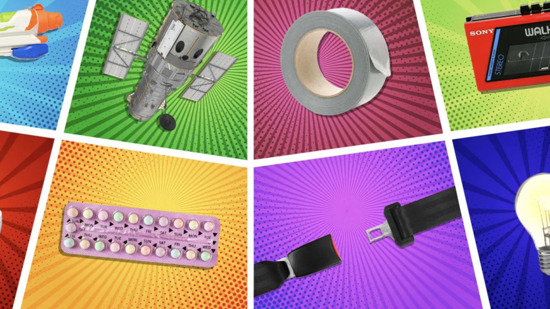
Great Inventions
Lesson 2

Slide 2
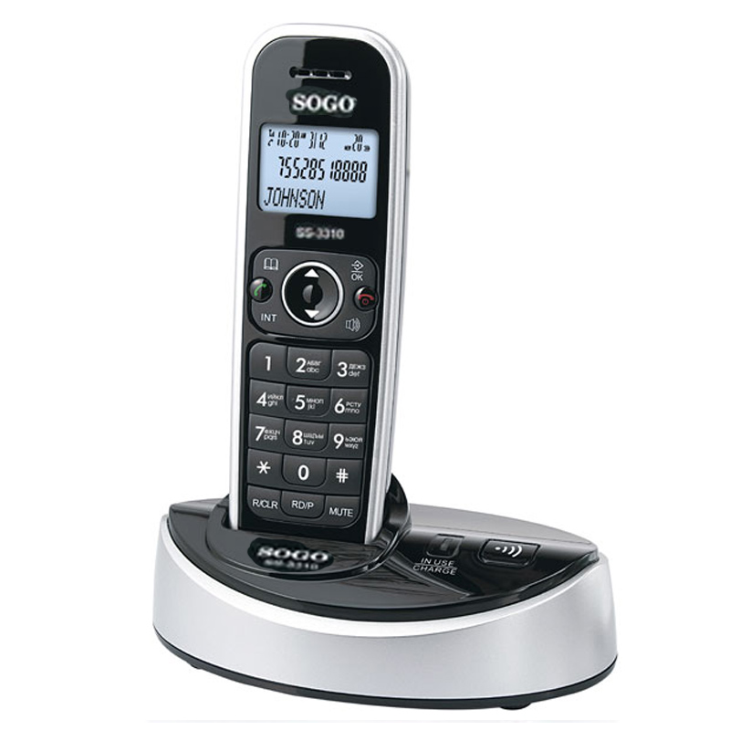
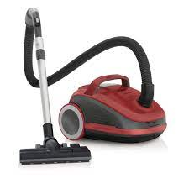
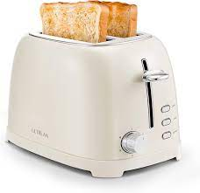
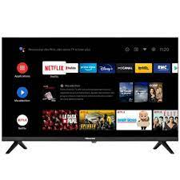
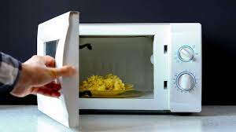
?

Slide 3
engineer
In 1849, Italian engineer Antonio Meucci made the first telephone. He came across the idea by accident when he was trying to find a cure for headaches.

Slide 4
demonstrating
Hubert Booth, a British engineer, went to watch an inventor demonstrating a cleaning machine that blew dust from the seats of railway carriages.

Slide 5
handkerchief
So, he put a handkerchief on a chair cushion. Pressing his mouth against it, he took a deep breath and breathed in a lungful of dust. Once he had stopped coughing, he turned the handkerchief over. On the back was a dark ring of dirt where his mouth had been.

Slide 6
dummy
He pointed it at the head of a dummy called ‘Stooky Bill’. Amazingly, it worked. An image of the dummy appeared on the little screen.

