Slide 1
Lesson 2 Listening
Year 5
English

Slide 2
Lesson 2 Objectives
In Lesson 2 you will:
listen and view a video clip.
answer questions about the video clip.

Slide 3
Lesson Resources
Questions Worksheet
Answers Handout

Slide 4
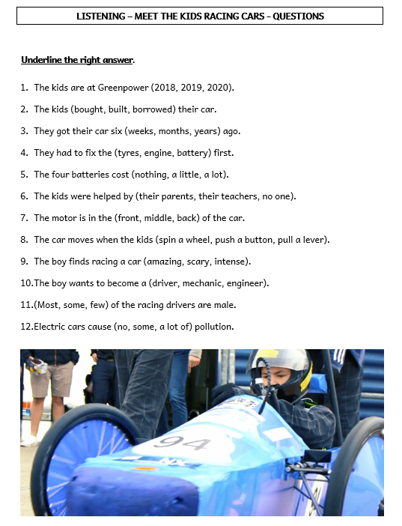
Step 1
READ the questions on the worksheet.

Slide 5
Step 2
LISTEN and VIEW the video clip.
LISTEN carefully to the questions.
START ANSWERING the questions.

Slide 7
Step 3
LISTEN and VIEW the video clip again.
LISTEN carefully to the questions.
START ANSWERING the questions.

Slide 9
Step 4

Slide 10
Step 5
CHECK your answers using the
Answers Handout.

Slide 11
Thank You!

