Slide 1
Disclaimers
We hope you find the information on our website and resources useful.
AI Disclaimer
Any factual information within this resource is accurate and based on current research as of April 2023. Any assumptions made in the analysis of this resource are not reflective of the position of Twinkl in relation to AI. Twinkl neither endorses nor is affiliated with any AI system referred to in this resource. AI systems are only as good as the data they are trained on and are vulnerable to bias and can provide incorrect information, therefore human editing is always advised. In order to ensure privacy is maintained, personal and sensitive data must not be entered into AI tools. Twinkl cannot be held responsible for the use of external AI tools; protecting children from harmful content online, including that generated by AI, should be of the utmost importance. As always, please ensure you check the suggested age-rating for any AI tools you choose to use.

Slide 2
Disclaimers
We hope you find the information on our website and resources useful.
Animations
This resource has been designed with animations to make it as fun and engaging as possible. To view the content in the correct formatting, please view the PowerPoint in ‘slide show mode’. This takes you from desktop to presentation mode. If you view the slides out of ‘slide show mode’, you may find that some of the text and images overlap each other and/or are difficult to read.
To enter slide show mode, go to the slide show menu tab and select either from beginning or from current slide.
Links to External Websites
This resource contains links to external websites. Please be aware that the inclusion of any link in this resource should not be taken as an endorsement of any kind by Twinkl of the linked website or any association with its operators. You should also be aware that we have no control over the availability of the linked pages. If the link is not working, please let us know by contacting TwinklCares and we will try to fix it although we can assume no responsibility if this is the case. We are not responsible for the content of external sites.

Slide 4
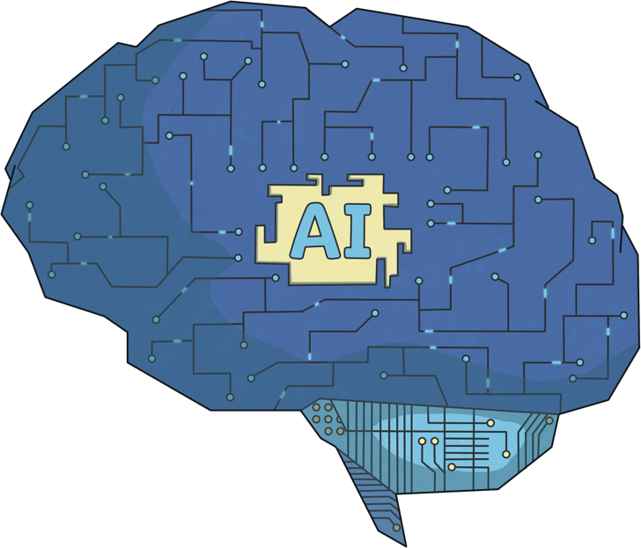
What Is AI?
Artificial intelligence (AI) refers to technology that can make computers learn and have human-like intelligence.
A machine can be programmed to perform human-like tasks, based on the information it takes from its surroundings and from previous experience. AI is able to process language, learn and problem-solve.

Slide 5
The History of AI
Although artificial intelligence can be traced back as far as the ancient times, the modern world of AI that we know today started to develop in the mid 20th century.
Alan Turing was a British mathematician, logician and computer scientist who laid the foundations of modern computers and made significant contributions to the field of artificial intelligence (AI). In 1935, he had discussed the potential of a computer machine having an unlimited amount of memory and developed the universal Turing machine. In one of his lectures in 1947, Turing said, “What we want is a machine that can learn from experience”.
The Turing machine is a concept that was one of Turing's great inventions. It was meant to be a mathematical concept, not a physical machine and was therefore never built. Turing's idea was to have a computer that was able to decode and perform a set of instructions. These ideas of mixing mathematics and computer science have contributed towards the way computers are built and used today.

Slide 6
Founding Fathers of AI
Many other scientists went on to develop Turing’s concepts further and were known as the 'founding fathers of artificial intelligence’.
Some significant moments in the initial development of AI can be dated back to the 1950s.
In 1958, John McCarthy created a programming language
that is known as Lisp. Lisp has been influential in the development of artificial intelligence. Many early AI systems were written in Lisp and it still continues to be used today in AI research.
In 1959, Arthur Samuel described the idea of teaching computers to automatically learn and improve from experience, without being explicitly programmed to do so. The computer learns from data and becomes better at making predictions or decisions as it receives more data. This idea is known as machine learning.
In 1952, computer scientist Arthur Samuel created a program where a computer could play game of checkers.
In 1955, scientist John McCarthy created the name artificial intelligence.

Slide 7
Programming Languages
Artificial intelligence typically uses algorithms to follow rules and determine how to respond to certain actions. These algorithms are able to tell the machine how to perform a task or solve a problem based on step-by-step instructions.
AI uses many different programming languages. Some of the languages that you may have experienced or be familiar with are:
There are many things that AI can do. Click the skills below to find out more.
natural language processing (NLP)
Python
image recognition
JavaScript
speech recognition

Slide 8
Programming Languages
Artificial Intelligence can use algorithms to follow rules and determine how to respond to certain actions. These algorithms are able to tell the machine how to perform a task or solve a problem based on step-by-step instructions.
There are many things that AI can do. Click the skills below to find out more.
natural language processing (NLP)
This is a machine’s ability to recognise and interpret human language. NLP can be used in apps to translate one language to another.
Back

Slide 9
Programming Languages
Artificial Intelligence can use algorithms to follow rules and determine how to respond to certain actions. These algorithms are able to tell the machine how to perform a task or solve a problem based on step-by-step instructions.
There are many things that AI can do. Click the skills below to find out more.
speech recognition
Speech recognition is where a machine can understand human language. You may have seen this being used in voice assistants, where a user gives a voice command and the machine will carry out a response.
Back

Slide 10
Programming Languages
Artificial Intelligence can use algorithms to follow rules and determine how to respond to certain actions. These algorithms are able to tell the machine how to perform a task or solve a problem based on step-by-step instructions.
There are many things that AI can do. Click the skills below to find out more.
image recognition
Image recognition is where a machine can recognise and classify images. This could be used on an image search or detecting people in photos. Some cars can detect objects ahead while driving and respond if needed.
Back

Slide 11
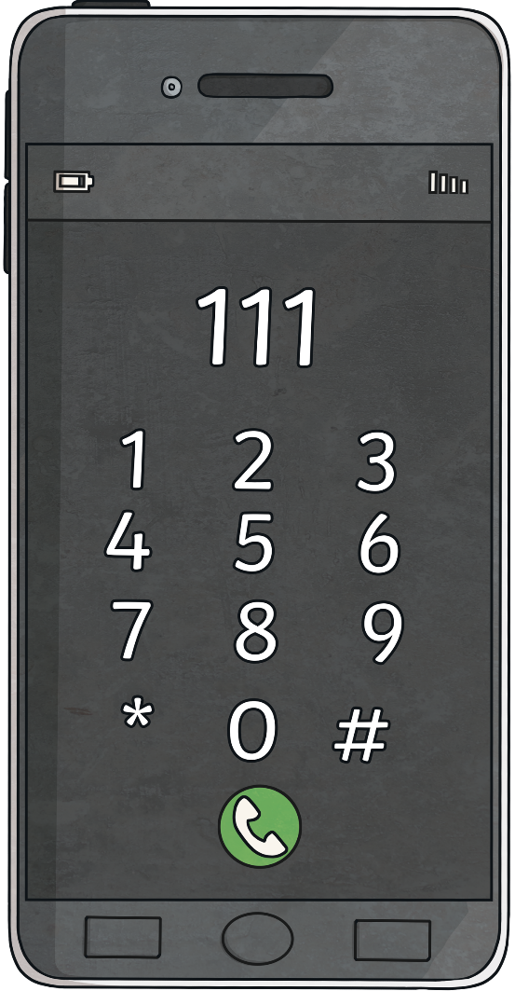
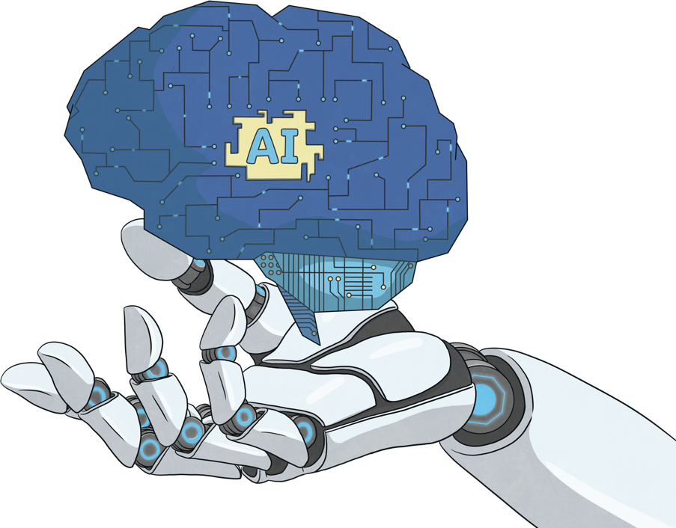
Making Predictions
AI works by processing large amounts of data. It uses algorithms to identify patterns and make predictions.
Have you ever watched a video online and when finished, a new suggested video appears for you to watch? This is AI predicting what you’d like to watch, based on the previous videos you have viewed.
AI can even scan a device's photo gallery and identify a person's face through thousands of photos. It can then categorise this person by selecting all photos that this individual appears in.
tw
two
twinkl
twin
How about when typing? Have you ever typed into a device such as a smartphone, laptop or tablet and seen it predict the next word or try to complete the sentence for you?

Slide 12
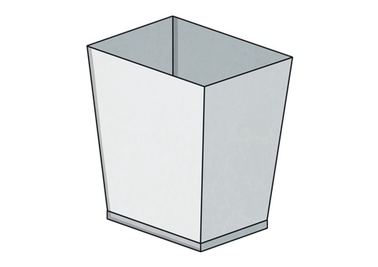
Making Decisions
Just like humans, AI can be trained to make decisions. AI is capable of processing data at a faster rate than humans.
Imagine training an AI to sort piles of rubbish into mixed waste and recycling. The AI has to sort all plastic bottles into the recycling bin but anything else must go into the mixed waste. Based on lots of pictures it has seen of bottles before (the data it has been trained on), the robot can compare this to other pictures, before making a decision on what to do. It will recognise the bottles and then place them in the correct bin. Click on the rubbish to see what happens.
Recycling
Mixed Waste

Slide 13
How Is AI Used Today?
There are many different ways that AI is used today. You may use AI regularly and not even realise! With a partner, see if you can think of the ways AI is used today or where you may have used or seen it.
Let’s take a look at some of the ways it is used:
in voice assistants, such as Siri, Alexa, Cortana and Google
on websites to personalise what you see
adverts tailored to your online searches and search history
facial recognition to access devices such as smartphones
in cars detecting when to slow down, stop or change lanes
smart home devices, such as thermostats and doorbells

Slide 14
What Are the Advantages of AI?
There are many different advantages of using artificial intelligence. Can you think of the ways AI could have a positive impact?
Here are a few examples that you may have thought of:
Human error is less likely.
AI does not require sleep or rest.
AI can be programmed to do repetitive tasks easily.
Decisions can be made quicker without outside influence.

Slide 15
What Are the Disadvantages of AI?
Stephen Hawking, a famous scientist, raised concerns over teaching computers to think too much like humans. Can you think why this might be?
You might have guessed that he, along with others, worried that if we teach computers to think and act too much like humans, that eventually, these computers may become smarter than humans. This could mean that some workplaces or jobs no longer require humans.
Here are some other potential disadvantages to AI:
AI can break and malfunction.
AI can be expensive to develop and maintain.
AI can be biased.
AI only knows what it has previously been shown.

Slide 16
Advantages and Disadvantages of Using AI
Look at your Advantages and Disadvantages of Using AI Activity Sheet.
List some advantages and disadvantages of using AI in our world today. It might help to think about:
what you have learnt about AI so far;
the positives of using AI;
the negatives of using AI;
how you use AI as an individual.

Slide 17
How Is AI Evolving?
AI technology is constantly evolving and scientists continue to work on something called machine perception. As part of this, scientists want the machines to be able to understand in a more human-like way, reacting to certain situations by using sensors to detect smells, taste, touch and what they hear.

Slide 18
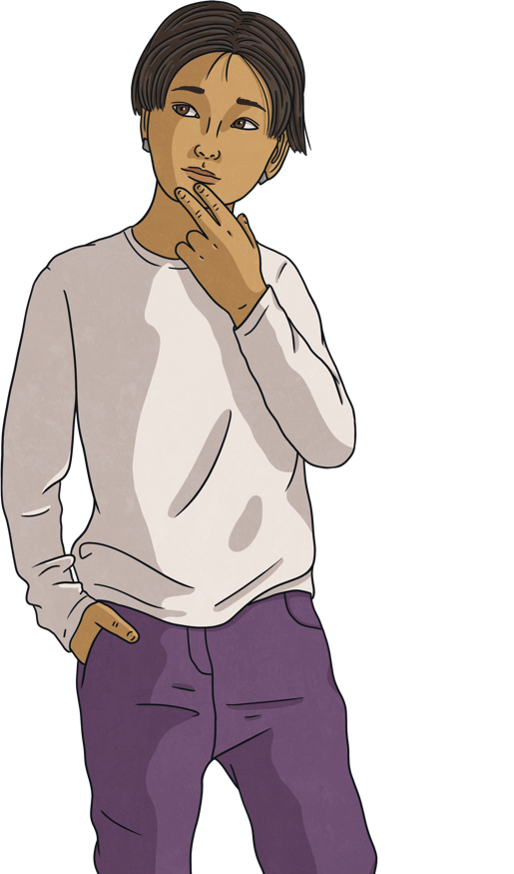
AI Safety
AI is a fast-developing technology. It is appearing more frequently in our everyday lives, so it is important to keep ourselves safe when we use it. Here are some tips to help you stay safe when using AI technology:
Remember, if you see anything that makes you feel uncomfortable online or on a device:
Only use AI technology that a trusted adult has given you permission to use.
Do not share personal information with AI systems, such as your name, address or phone number.
AI systems are not perfect and can make mistakes, so always double-check information you receive from them.
Report
Report via the online site that you experienced it on. Tell a trusted adult about it and ask for help.
Save
Keep evidence; take screenshots.
Stop
Stop using the device immediately.

