Slide 1
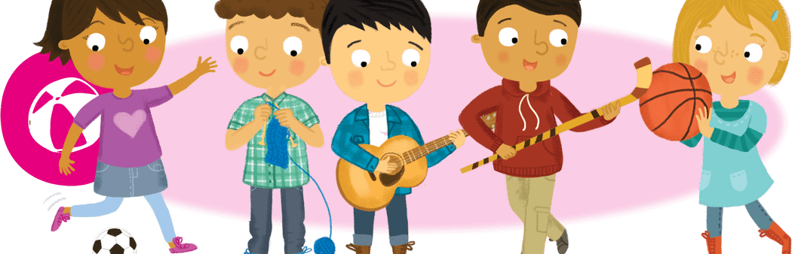
Hobbies and Free Time
Lesson 3: Literature

Slide 2
Notes for the Educator
This lesson is pegged directly to Learning Outcome LIT 5.3 I can respond to simple poems, stories, and plays by speaking and writing briefly about how I feel about the literary texts and about the events and characters in these texts.
Teachers are to refer to the Scheme of Work where each lesson is explained in more detail.
The book Max’s Words by Kate Banks featured in this lesson may be accessed on: https://www.youtube.com/watch?v=QEpDSQ4hNA0
Effects are included to make the presentation more interactive. Please present the PowerPoint in Slideshow mode.
Wherever possible we have included the use of online apps to enhance the teaching and learning experience.
The Notes section underneath the slides may contain some further points which can be developed during the lesson.
Teachers are encouraged to adapt this PowerPoint presentation to meet the learners’ language needs.
Tasks included in the PowerPoint presentation are also being shared as handouts.
For any comments, feedback or suggestions please email us at: marie-claire.camilleri@ilearn.edu.mt; urieth.attard@ilearn.edu.mt; mary.jude.camilleri@ilearn.edu.mt. You may also call the office on: 25983683.

Slide 3
I am learning how to enjoy and understand a literary text.
I can make predictions about the text.
I can read the text aloud.
I can answer questions about it.

Slide 4
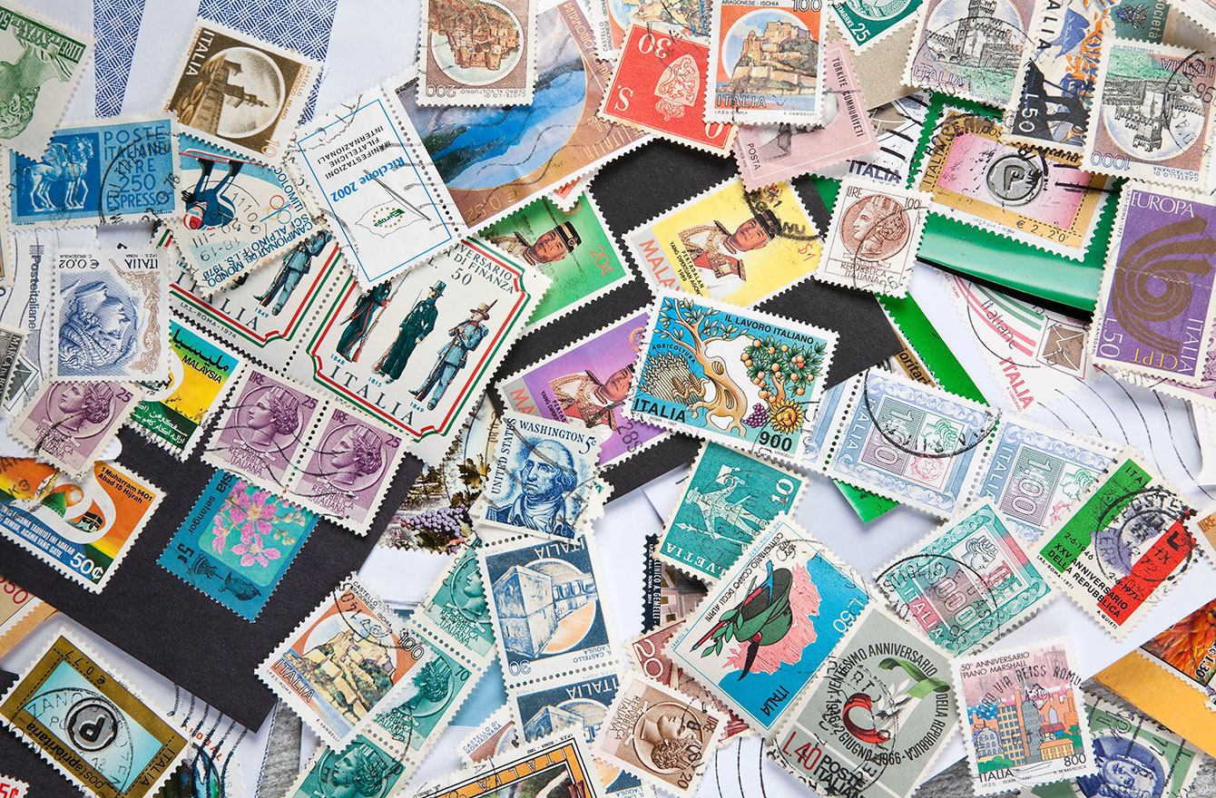
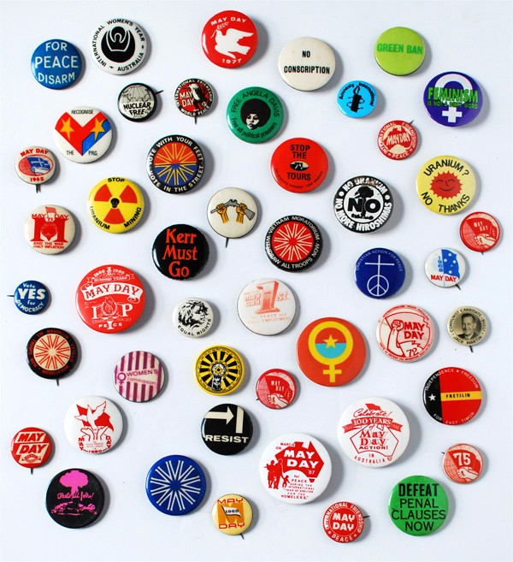
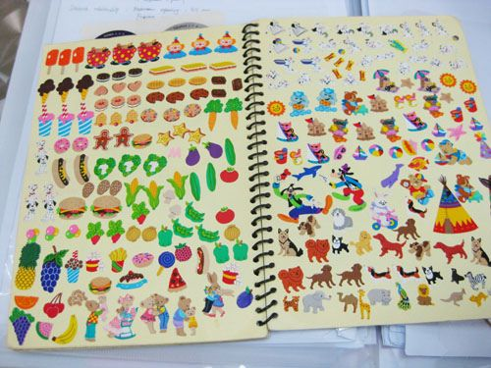
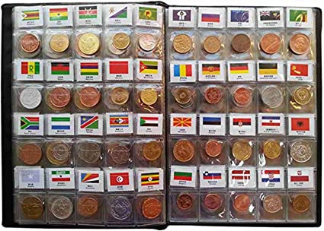
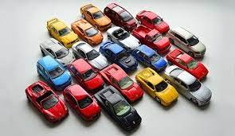
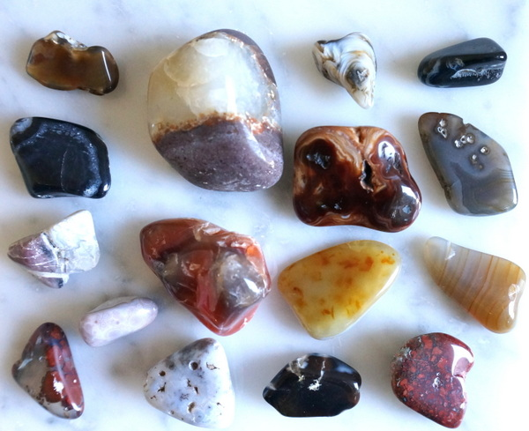
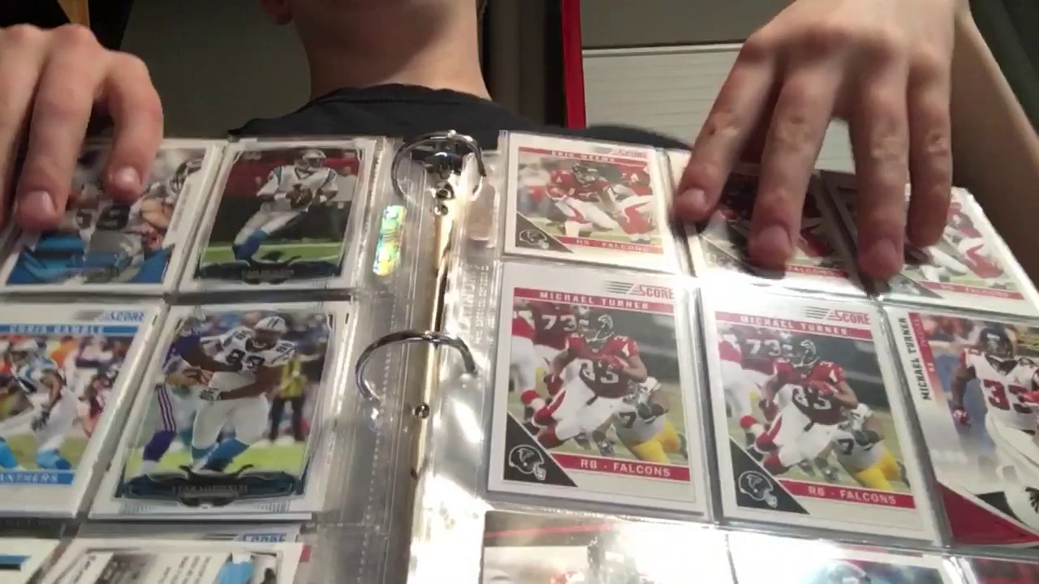
Notes:
In this lesson we are going to talk about Special Collections. Keeping a collection is a popular hobby enjoyed by many people. What things do people collect? Take a couple of minutes to brainstorm things that people collect. Do you collect anything? What made you start this collection? Where do you keep your collection?

Slide 5
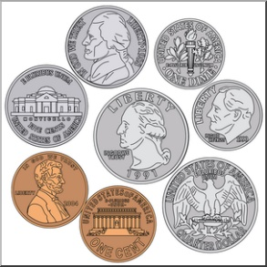
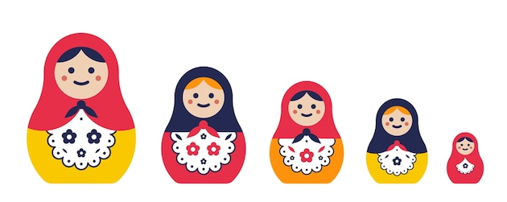
What do you collect? by Wes Magee
What do you collect?
Coins, dolls from other lands?
Or jokes that no one understands?
Notes:
Since the theme in the book that we re going to read is keeping a collection, I would like to start off by sharing with you a poem by Wes Magee called What do you collect? As you listen to the poem, think about these strange or not so strange collections.

Slide 6
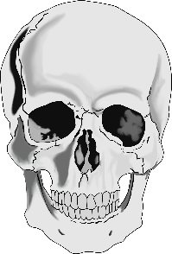
What do you collect?
Skulls, posters, badges, bells?
Or walking sticks or seaside shells?

Slide 7
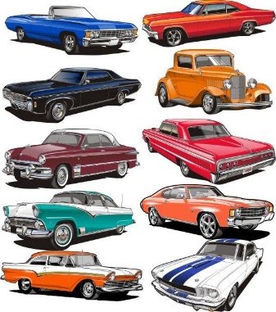
What do you collect?
Stamps, gem stones, model cars?
Or wrappers torn from chocolate bars?

Slide 8
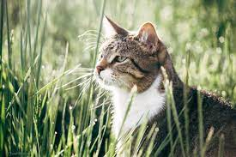
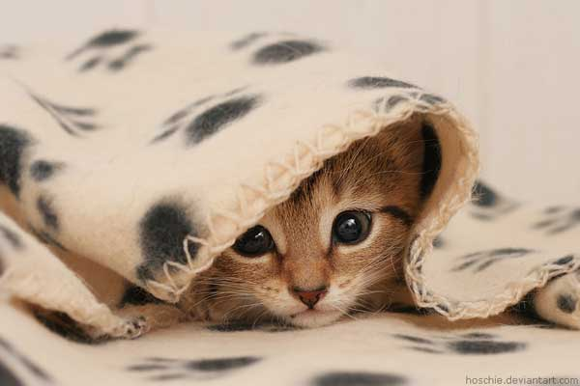
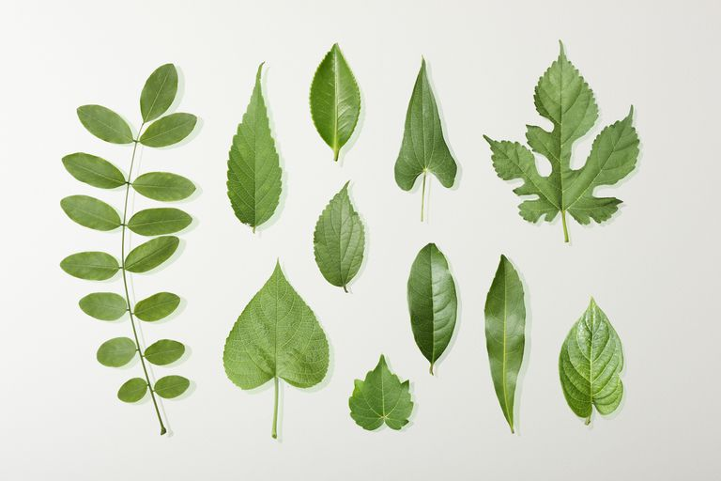
What do you collect?
Leaves, photographs of cats?
Or horror masks and rubber bats?

Slide 9
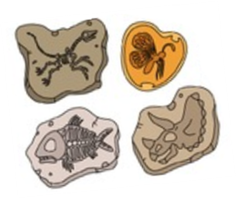
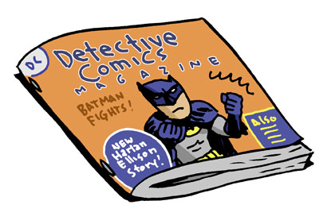
What do you collect?
Books, fossils, records, rocks?
Or comics in a cardboard box?
Notes:
Right, so this poem asks the reader a question: What do you collect? Each stanza starts with the same question and then the poet gives different examples of strange and not so strange things to collect. Which things might be a bit strange or difficult to keep as a collection? Which things are more common? Which things would you collect?

Slide 10
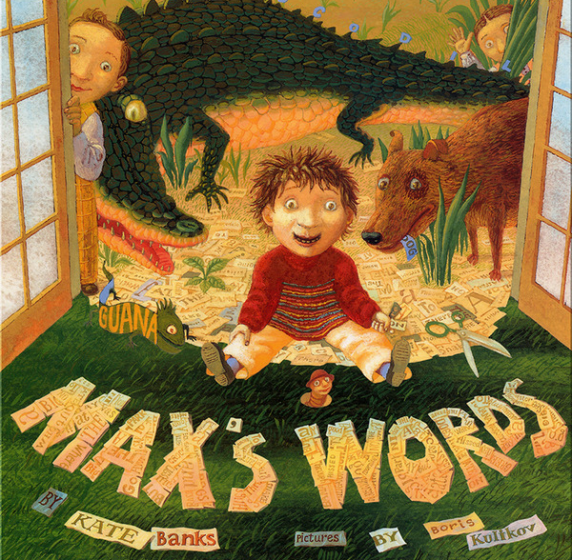
I see…
I think…
I wonder…
Notes:
Let’s have a look at the front cover of the book. What can you see? What do you notice about the title of the book? What do you notice about the words making up the name of the author and the illustrator? What do you think Max’ collects?
How many children can you see in all?
Who are the other two children?
Why are their animals in the picture?
Now, let’s say something about what we see, what we think will happen in the book and what we are wondering about…Let me give you an example.
I see a pair of scissors on the floor.
I think Max cuts words from old magazines or newspapers.
I wonder what he does with all these words?

Slide 11
ragged
Notes:
But before we start reading the passage from the book, let’s go through some words that might be new or difficult to read. The first word is ragged. When something is ragged, it means it is not cut in a straight way.

Slide 12
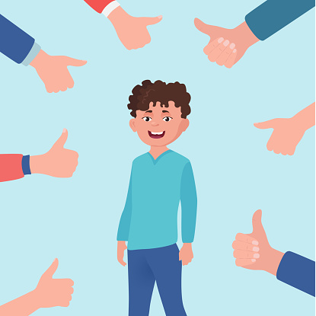
admired
Notes:
This word is admired. When someone admires something he or she think that it’s very good.

Slide 13
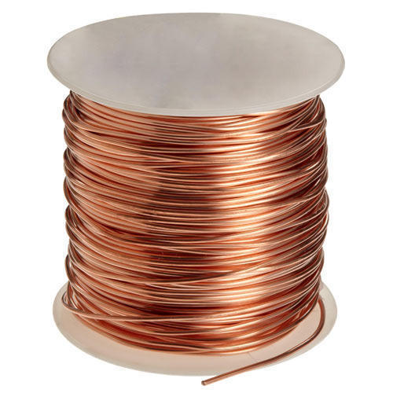
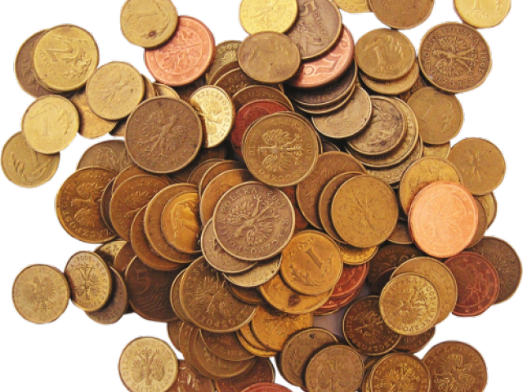
copper
Notes:
Copper is a material of a reddish brown colour. It is commonly used in coins.

Slide 14
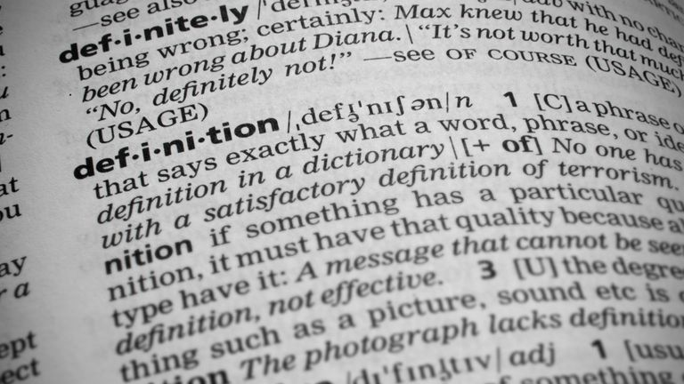
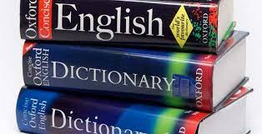
dictionary
Notes:
A dictionary is a book that tells you the meaning of words.

Slide 15
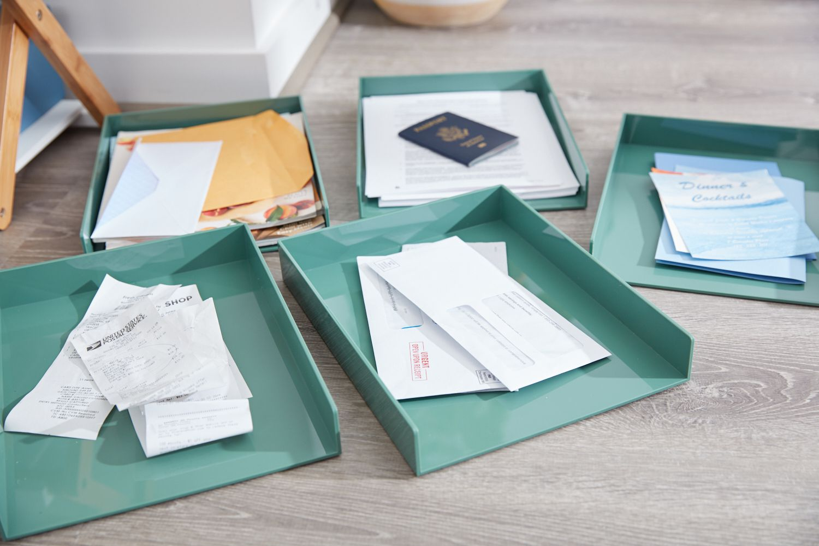
separated
Notes:
Separated – put them apart, sort them

Slide 16
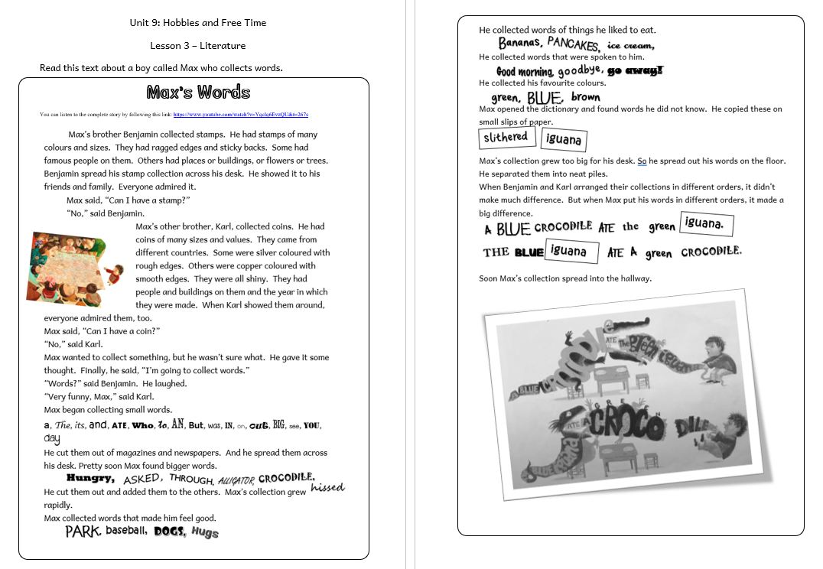

Slide 17
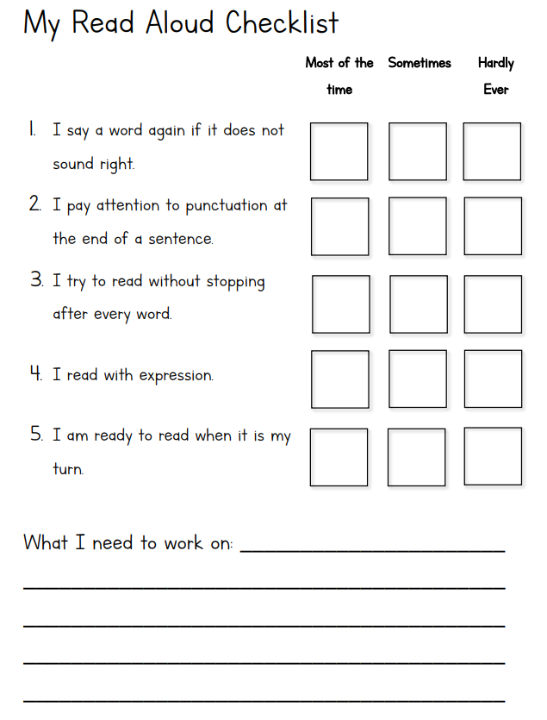

Slide 18
Answer these questions
about the text.
1. What did Max collect?
Stamps □
Words □
Coins □
Notes:
In this question we need to give information that is stated in the text. There is one correct answer.
You probably already know the answer, but let’s look at the text to confirm our answer. We need to find the part that tells us about what Max decides to collect.

Slide 19
Look at the text...
Notes:
Let’s read this part together first. So, it is very clear, the answer is words.

Slide 20
Answer these questions
about the text.
2. Find and copy a word that describes the edges of the stamps.
Notes:
So, this question asks us to take a closer look at the language in the text, the words. We need to find a word that describes the edges of stamps. We need to find an adjective that describes how the edges of the stamps looked. We need to look back to the text and find the part that describes Benjamin’s stamps.
Examine and Evaluate Content, Language, and Textual Elements

Slide 21
Look at the text...

Slide 22
Answer these questions
about the text.
3.a. Do you think at first Benjamin and Karl liked Max’s idea of collecting words?
Yes No
3.b. Explain your answer.

Slide 23
Look at the text...
They thought it was a silly idea.
NO
They laughed at him.
Benjamin laughed at him and Max found it funny.
Notes:
So, in this question, first we need to say yes or no, and then we need to explain why we think it’s a yes or a no. These are all ideas of how you can say the same thing.

Slide 24
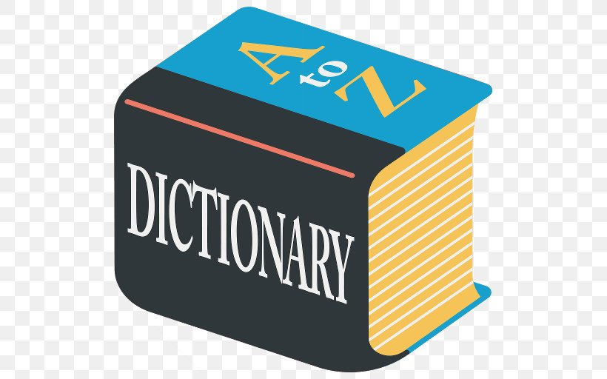
Answer these questions
about the text.
4. Why did Max use a dictionary?

Slide 25
Look at the text...
To find words he did not know.
To find the meaning of words he did not know.
To find words he did not know and copy them on paper.
Notes:
POSSIBLE ANSWERS COULD BE…

Slide 26
Answer these questions
about the text.
5. Max began collecting small words first. What other kind of words did he collect afterwards? Give two examples.
a. ___________________________
b. ___________________________

Slide 27
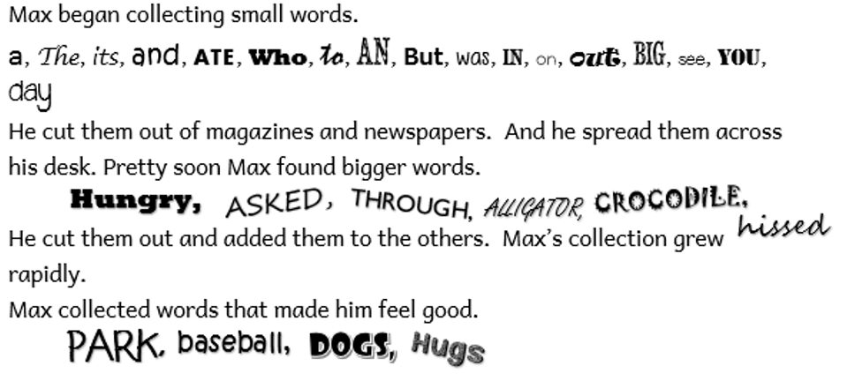
Look at the text...
Notes:
We have found two kinds of words that Max collected. But we can look for more. Let’s keep on reading…

Slide 28
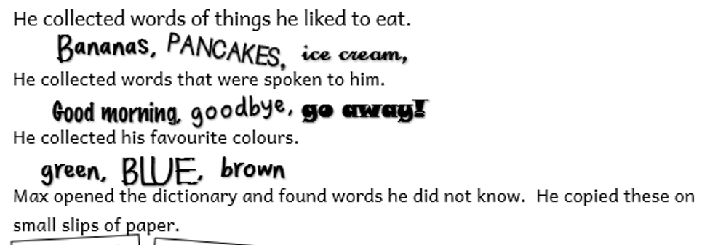
Look at the text...
Notes:
So, here we have four other kinds of words that Max collected. Wow, altogether in the text there are six. But we only need two. So we need to decide which two.

Slide 29
Look at the text...
◆
big words

words that made him feel good

words of things he liked to eat

words that were spoken to him

his favourite colours

Words he did not know

Slide 30
Answer these questions
about the text.
6.a. Why did putting Max’s words in different order make a big difference?
b. How was this different to Benjamin’s and Karl’s collections?

Slide 31
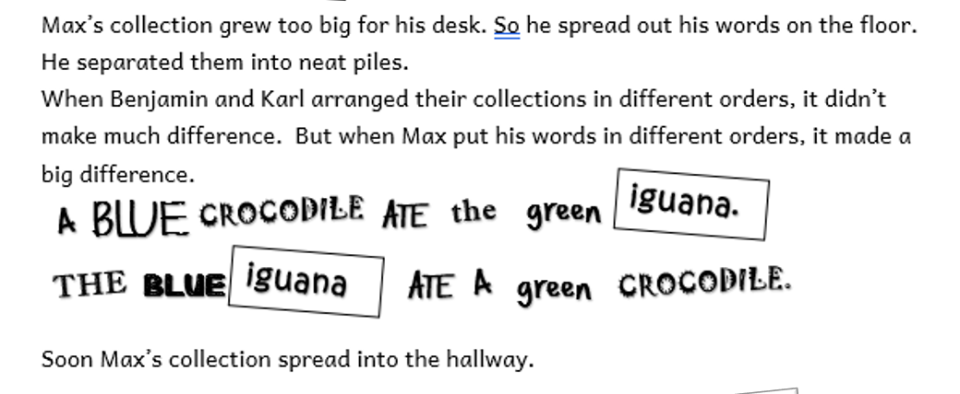
Look at the text...

Slide 32
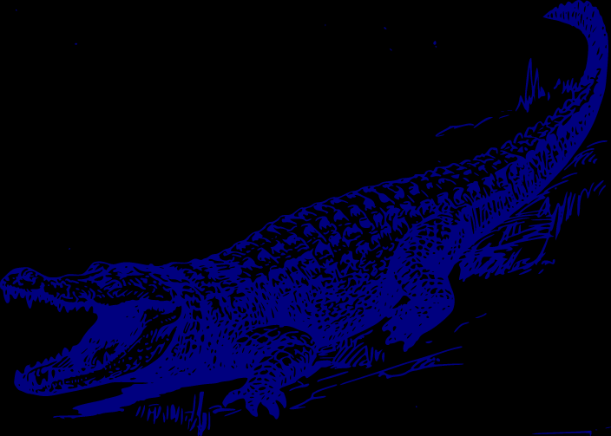
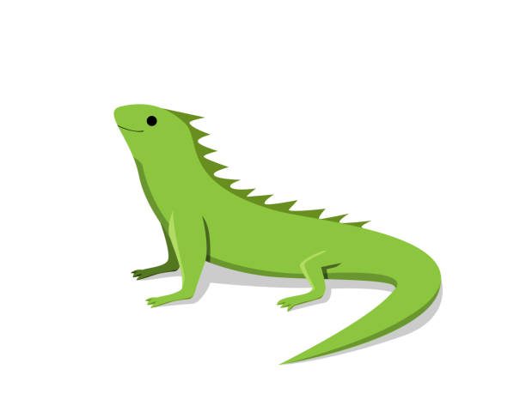
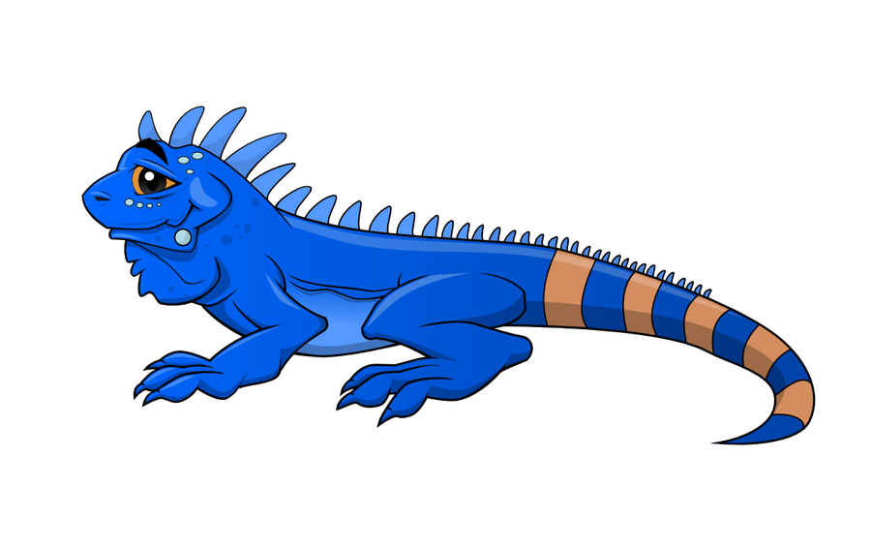
Look at the text...

Slide 33
Answer these questions
about the text.
6.a. Why did putting Max’s words in different order make a big difference?
b. How was this different to Benjamin’s and Karl’s collections?
The meaning of the sentence changes.

Slide 34
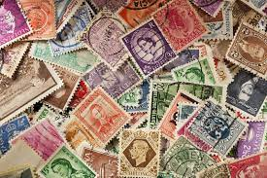
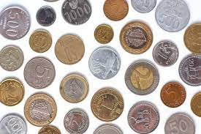
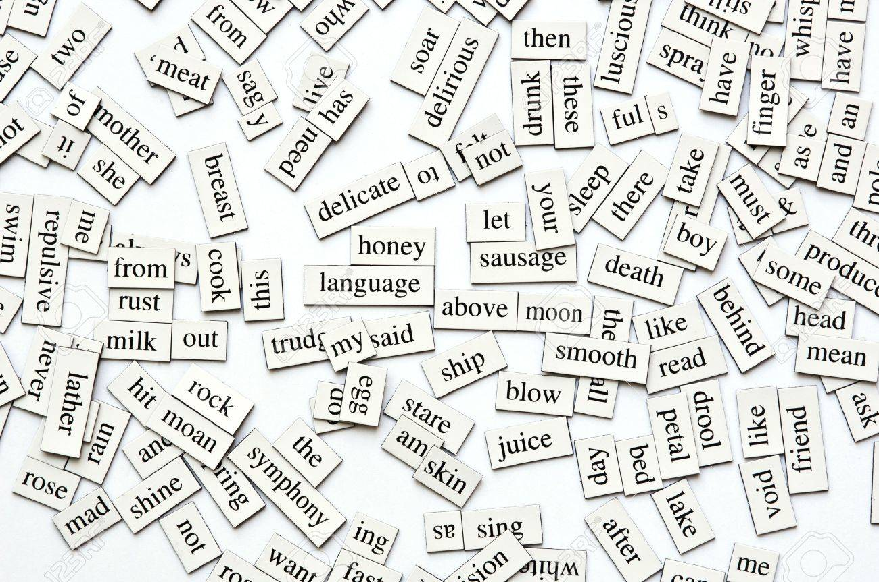
Look at the text...
Benjamin
Karl
Max

Slide 35
Answer these questions
about the text.
7. If you were collecting words like Max, which three words would you collect? How can you describe these words? Look at Max’s example:

Slide 36
Answer these questions
about the text.
e.g. blue | favourite colours
1.
2.
3.

Slide 37
Thank you for using this resource. Check out our latest resources below.

