Slide 1
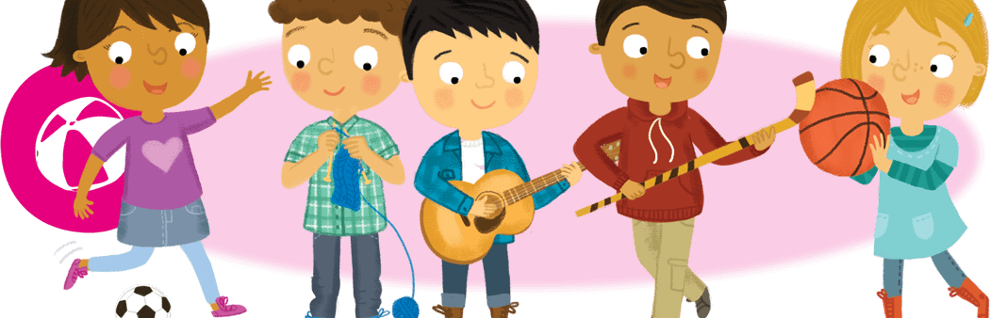
Hobbies and Free Time
Lesson 4: Speaking

Slide 2
Notes for the Educator
This lesson is pegged directly to Learning Outcome LS 5.8 I can communicate my own experiences, likes and dislikes fluently and accurately with some allowance to self-correct in the process and LS 5.15 I can convey a message accurately and clearly.
Teachers are to refer to the Scheme of Work where each lesson is explained in more detail.
Effects are included to make the presentation more interactive. Please present the PowerPoint in Slideshow mode.
Wherever possible we have included the use of online apps to enhance the teaching and learning experience.
The Notes section underneath the slides may contain some further points which can be developed during the lesson.
Teachers are encouraged to adapt this PowerPoint presentation to meet the learners’ language needs.
Audio files or links to websites may be included.
Tasks included in the PowerPoint presentation are also being shared as handouts.
For any comments, feedback or suggestions please email us at: marie-claire.camilleri@ilearn.edu.mt; urieth.attard@ilearn.edu.mt; mary.jude.camilleri@ilearn.edu.mt. You may also call the office on: 25983683.
Notes:
.

Slide 3
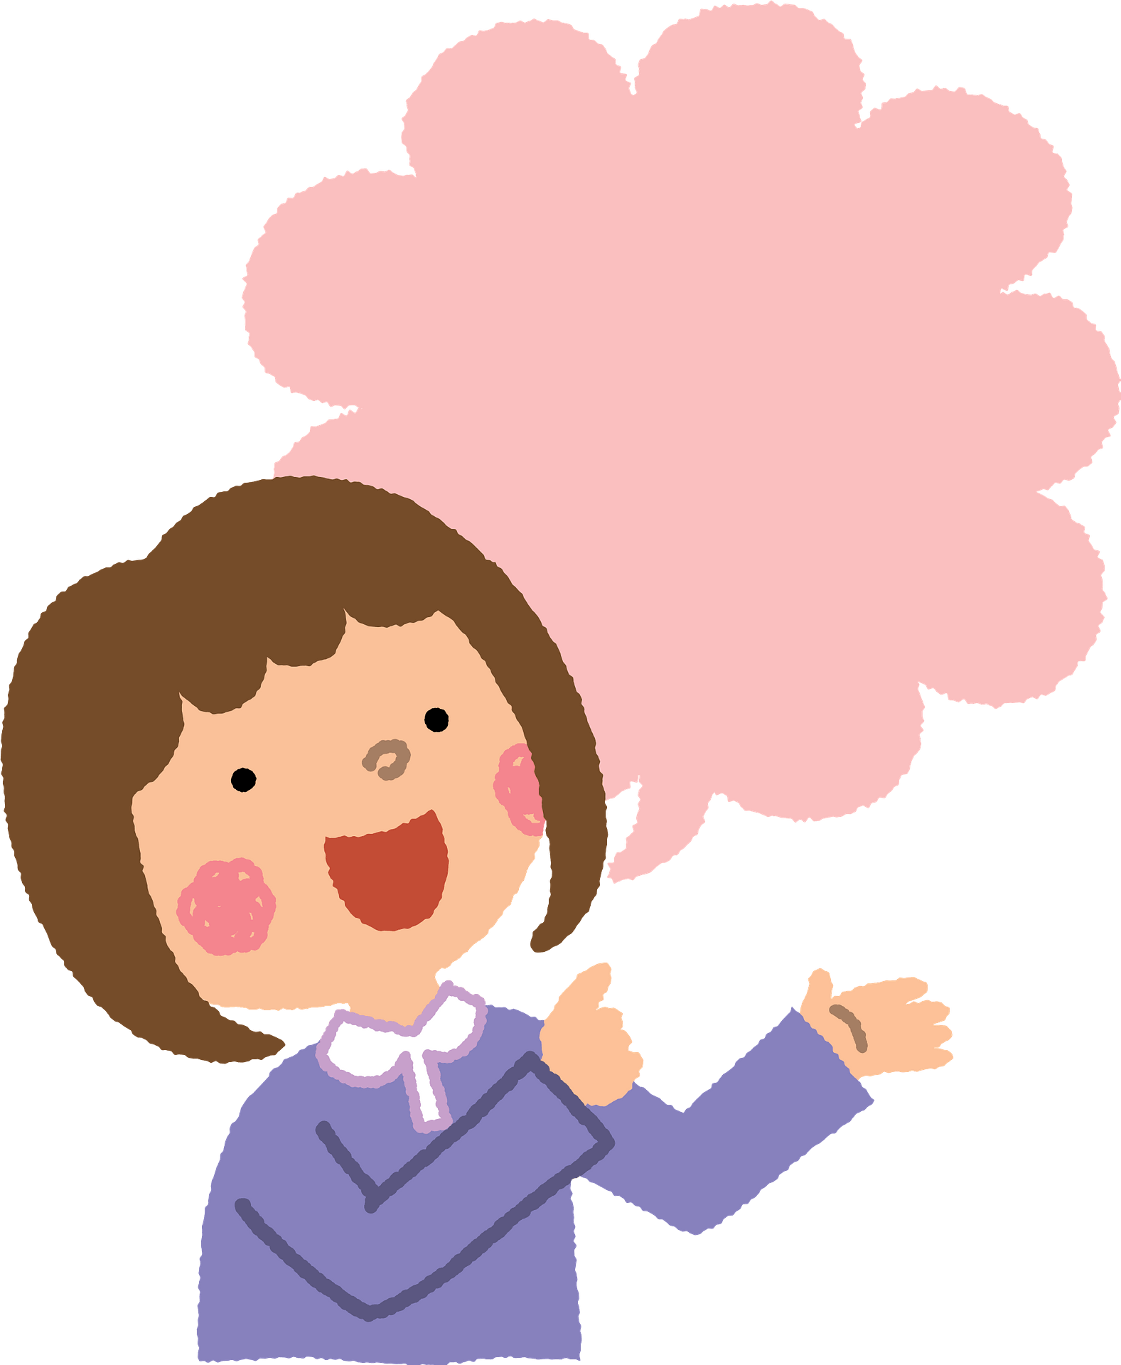
I am learning how to talk about hobbies.
I can use adverbs to show how often something is done.
I can use verbs in the present tense correctly.
I can self correct some mistakes I make while speaking.

Slide 4
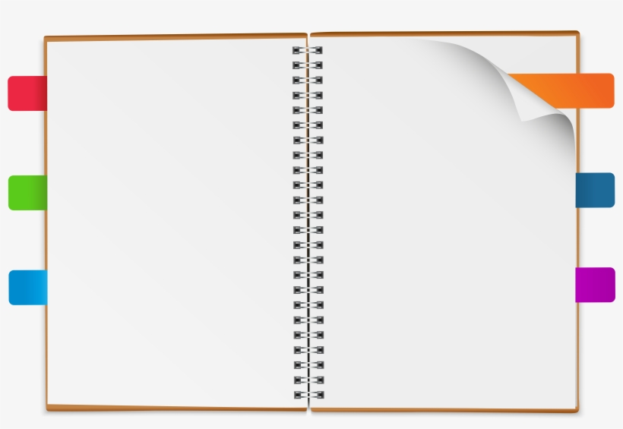
What are their hobbies?
Activity 1
Notes:
We are going to meet some people who are sharing some information about their hobbies.

Slide 5
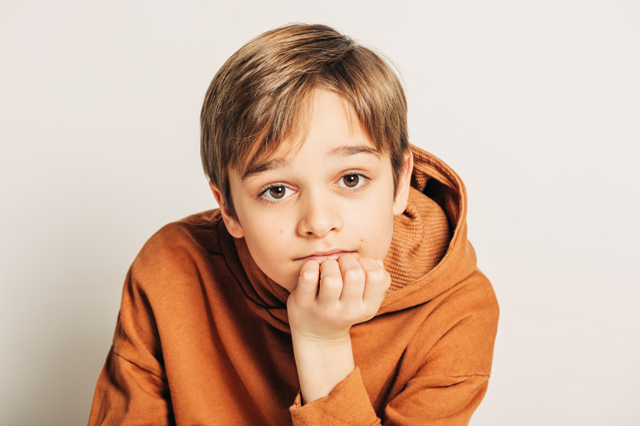
Name | Jack
Amount of free time | 1 hour everyday
On Wednesday | plays basketball
Twice a week | goes swimming
Sometimes | goes to the cinema with friends
In Summer | goes on holiday with his family
Jack
This is Jack. He has 1 hour of free time everyday. Every Wednesday, he plays basketball. He goes swimming twice a week.. Sometimes, he goes to the cinema with his friends. In Summer, Jack goes on holiday with his family.

Slide 6
twice a week
Words that show how often something is done
- Adverbs -
sometimes
usually
everyday
always

Slide 7
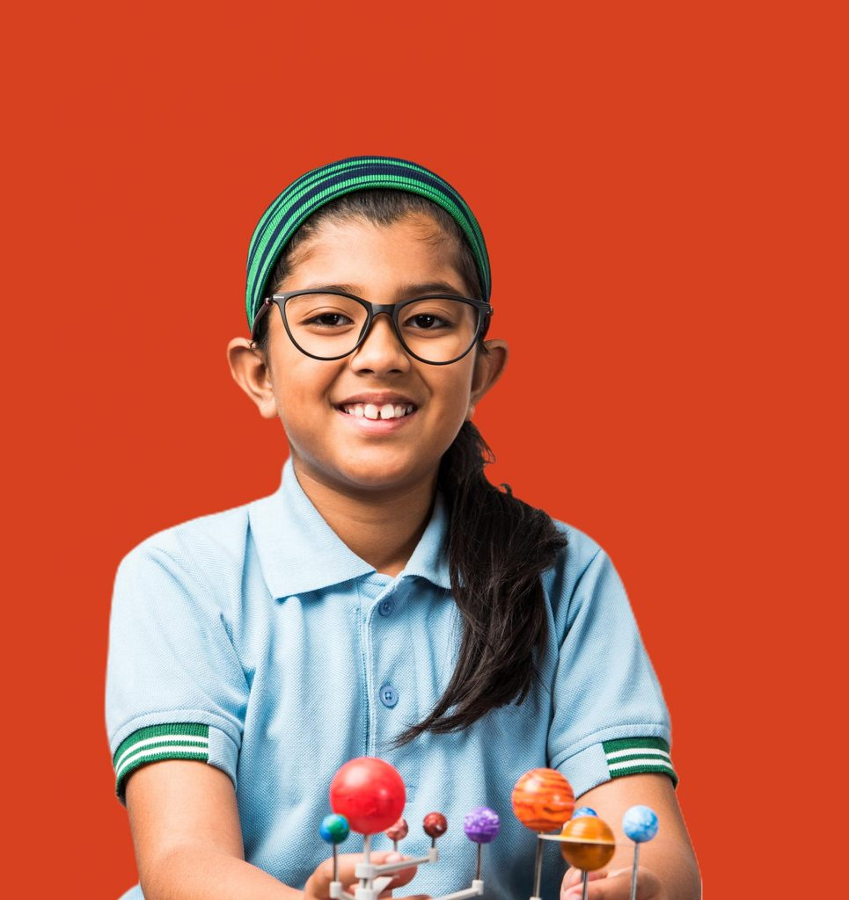
Name | Karla
Amount of free time | very little
Every day | reads books about space and astronomy
Sometimes | plays with her friends
During the weekend | goes to the park
In Summer | goes to a young scientists club
Karla
This is Karla. She has very litte free time during the week. Every day, she reads books about space and astronomy. Sometimes, she plays with her friends. During the weekend, she enjoys going to the park. In Summer, Karla goes to a young scientists club.

Slide 8
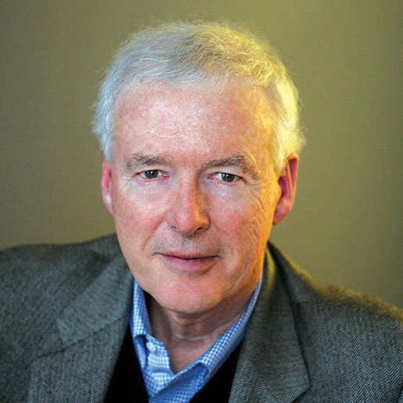
Name | Mario
Amount of free time | a lot
In the morning | takes the dog on a walk
In the afternoon | watches tv
In the evening | does crossword puzzles
Sometimes | meets his friends at a cafe
Mario
This is Mario. He has ____________________. In the mornings, he ____________________. In the afternoon, ____________________. In the evening, he ______________________. Sometimes, he ________________________________..

Slide 9
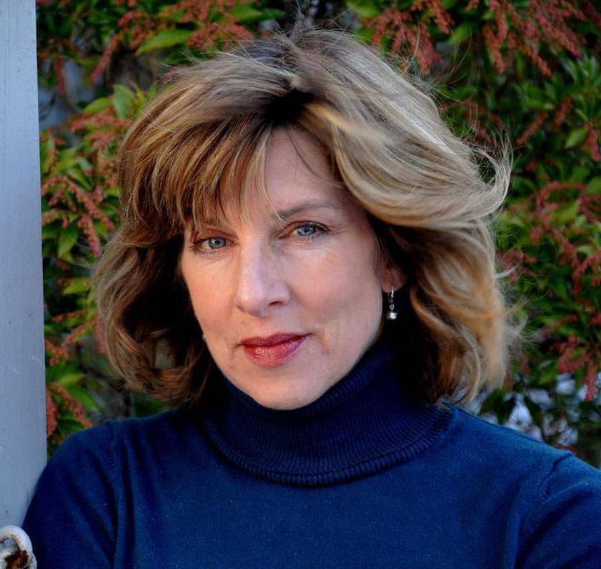
Name | Hannah
Amount of free time | not enough
Every day | reads before she falls asleep
Usually | goes for a run
Sometimes | watches romantic films on tv
In Spring | loves to go trekking around the maltese islands
Hannah
This is Hannah. She doesn’t have ____________________. Every day, she ____________________. She usually ____________________. Sometimes, she ______________________. In Spring, she ________________________________..

Slide 10
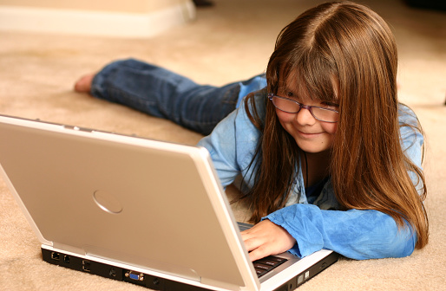
Name | Nora
Amount of free time | about 2 hours everyday
Every day | plays computer games
Sometimes | plays multiplayer games with her friends
Often | reads computer magazines
In Summer | goes to coding classes
Nora
This is ….
She ….
She….everyday.
Sometimes, she…
She often…
In Summer…

Slide 11
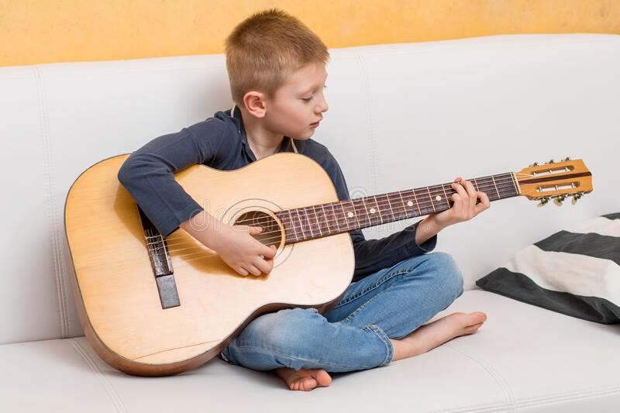
Name | Ryan
Amount of free time | 1 hour everyday
Twice a week | guitar lessons
Every day | listens to music and practices the guitar
Often | rides his bike after school
On Saturday nights, | watches a movie with his family
Ryan
This is ….
He ….
Twice a week, he….
He...everyday.
He often…
On Saturday nights…

Slide 12
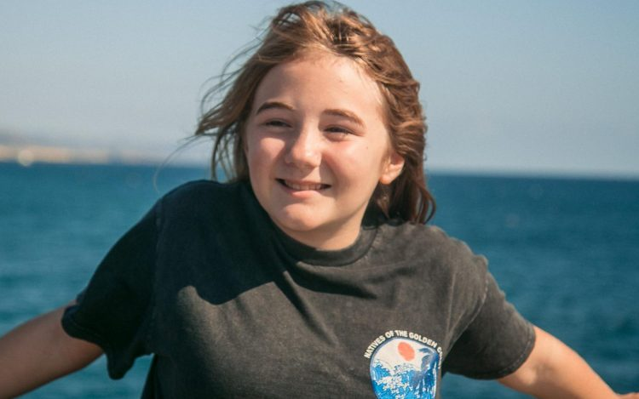
Naomi
Name | Naomi
Amount of free time | 2 hours every week
Once a week | attends girl guides
Often | reads adventure books
Sometimes | goes window shopping with her mum
During the weekend, | loves to be outdoors, goes hiking or camping
This is ….
She ….
Once a week, she….
She often….
Sometimes, …
During the weekend…

Slide 13
What about you?
Name
Amount of free time
Once a week
Usually
Sometimes
During the weekend,
My name is…
I have…
Once a week…
Usually…
Sometimes
During the weekend…
Notes:
Now, why don’t you try doing one for yourself. If not for yourself you can do one for a person in your family. You can use the information you collected about the hobbies of your family members in our first lesson.

Slide 14
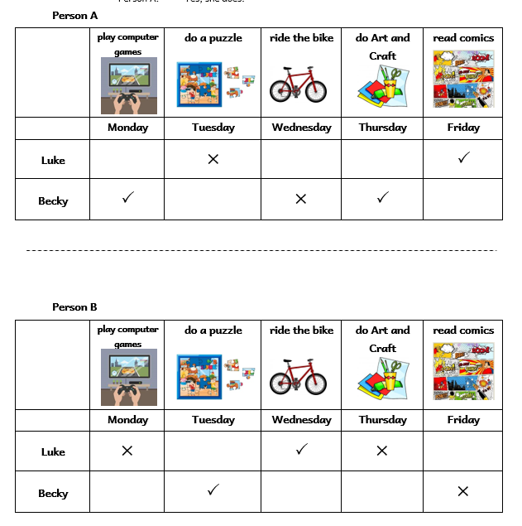
Activity 2
Information Gap
Notes:
This is an Information Gap activity. Learners need to have the handout that is available with this lesson.

Slide 16
play computer games
on Monday?
Does
Luke
do a puzzle
on Tuesday?
Does
ride the bike
Becky
on Wednesday?
do Art and Craft
on Thursday?
read comics
on Friday?

Slide 17
Person A
Does Luke play computer games on Monday?

Slide 18
Person B
No, he doesn’t.

Slide 19
Person B
Does Luke read comics on Friday?

Slide 20
Person A
Yes, he does.

Slide 21
Yes, he does.
No, he doesn’t.
Yes, she does.
No, she doesn’t.
does not.
Notes:
.

Slide 22
Thank you for using this resource. Check out our latest resources below.

