Slide 1
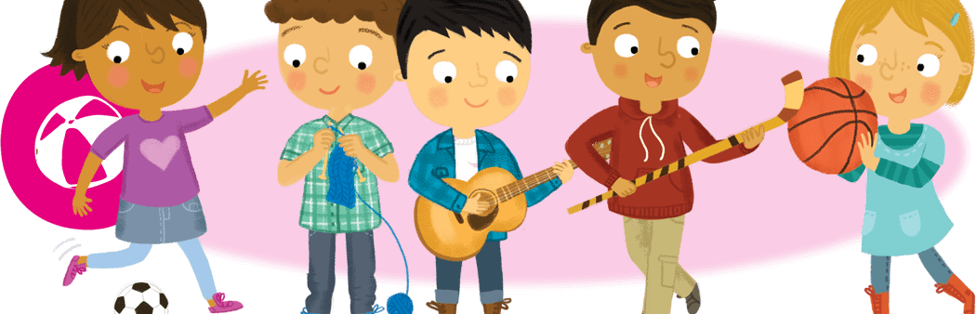
Hobbies and Free Time
Lesson 2: Reading

Slide 2
Notes for the Educator
This lesson is pegged directly to Learning Outcome R 5.5 I can use a range of strategies to aid comprehension and find the required information in the text and R 5.7 I can make informed assumptions about a text or long work from its title and introductory material
Teachers are to refer to the Scheme of Work where each lesson is explained in more detail.
Effects are included to make the presentation more interactive. Please present the PowerPoint in Slideshow mode.
Wherever possible we have included the use of online apps to enhance the teaching and learning experience.
The Notes section underneath the slides may contain some further points which can be developed during the lesson.
Teachers are encouraged to adapt this PowerPoint presentation to meet the learners’ language needs.
Audio files or links to websites may be included.
Tasks included in the PowerPoint presentation are also being shared as handouts.
For any comments, feedback or suggestions please email us at: marie-claire.camilleri@ilearn.edu.mt; urieth.attard@ilearn.edu.mt; mary.jude.camilleri@ilearn.edu.mt. You may also call the office on: 25983683.

Slide 3
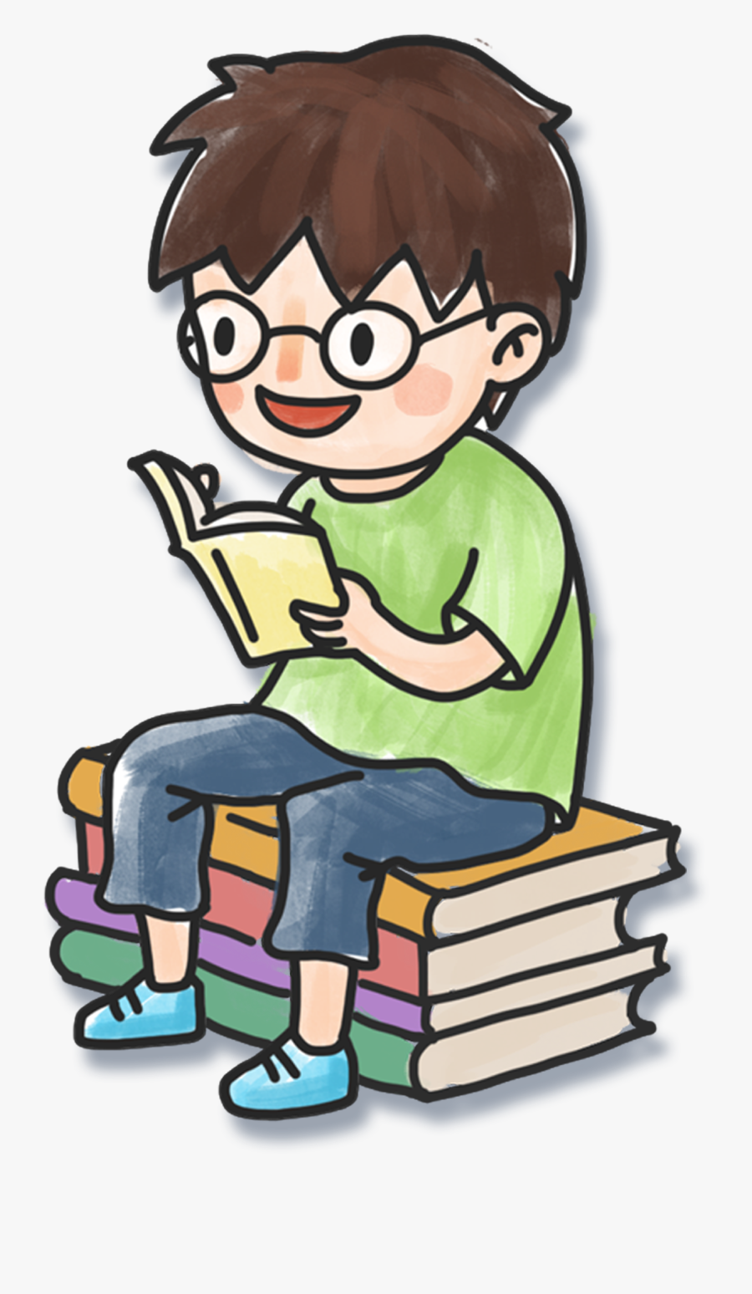
I am learning how to read and respond to a non-fiction text.
I can identify the purpose and who it is aimed for.
I can use different strategies to read and find information.
I can answer questions about the text.

Slide 4
Task 1: Reading a Time-Table

Slide 5
Task 1: Reading a Table

Slide 6
1. Who do you think made this timetable? (author)
2. Who will read it? Who is it for? (audience)
3. Why did they make it? (purpose)

Slide 7
Answer True or False
 | True | False
Mark practices four kinds of sports.
On Monday Mark rides his bike for an hour.
On Tuesday mark plays tennis.
On Wednesday Mark plays the guitar.
Marks spends half an hour reading on Thursday.
Every Friday, Mark visits his grandpa between 4 to 5 pm.
Task 2
Notes:
Click on the grid icon on the right to look at the time-table again.

Slide 8
Mark practices four kinds of sports.
Notes:
Four kinds of sports…

Slide 9
On Monday Mark rides his bike for an hour.

Slide 10
On Tuesday mark plays tennis.

Slide 11
On Wednesday Mark plays the guitar.

Slide 12
Marks spends half an hour reading on Thursday.

Slide 13
Every Friday, Mark visits his grandpa between 4 to 5 pm.

Slide 14
Task 2: Reading a Poster

Slide 15
EARLY BIRD
QUALIFIED
DISCOUNT
DROP IN RATE
CALL OR TEXT
Notes:
A poster is very similar to an advertisement.

Slide 16
REGISTRATION OPEN
COMPETE
DIY
LIMITED SEATS
BOOK YOUR SLOT

Slide 17
ELEMENTARY
STRATEGY
ENTRY FEE
NO AGE RESTRICTIONS

Slide 18
1. Who do you think made these posters? (author)
2. Who will read them? Who are they for? (audience)
3. Why did they make them? (purpose)
Notes:
Who do you think made these posters? Probably the persons in charge of the clubs/ workshops.
Who will read them? They will mostly be read by children – that’s why they are so colourful and appealing. They might also be read by parents who are interested in sending their children to after school clubs or classes to learn new things that are not normally done in school.
Why did they make them? Here we are thinking about the purpose. The purpose is to persuade the reader to attend the club or the workshop. They are similar to advertisements in that they want the reader to buy a service.

Slide 19
 |  | True | False
a. | The Robotic Workshop is held on Saturday.
b. | Teenagers can apply for the workshop.
c. | Each workshop lasts 2 hours.
d. | You can play against other children.
e. | The Robotic Masters workshop costs €500.
f. | This icon shows you where you can call for more information.
€
€

Slide 20
Information about Kids Music Classes
a. | A surname | ______________
b. | A day of the week | ______________
c. | the name of the school | ______________
4. | time | ______________
5. | telephone number | ______________
McCreesh
Wednesday
St Vincent De Paul
2.50 pm
0876878006

Slide 21
a. | Huston Elementary School is a school for (teenagers, young children, toddlers).
b. | You can play chess (with teachers, with other children, against the computer).
c | They accept children (older than 7 years, less than 9 years, of all ages).
d. | Each child pays $10 (once, for every session, every week).
e. | The club will be held in the (music room, hall, library).

Slide 22
B.4. Answer these questions.
a) Which of these clubs would you join? ______________________________
b) Why? ______________________________________________________
c) Give one example of how you can get more information about the club you wish to attend
______________________________________________________
Notes:
Have learners think about which one of these classes or clubs they would like to attend. They need to give a reason why they would like to join that club.

Slide 23
Thank you for using this resource. Check out our latest resources below.

