Slide 1
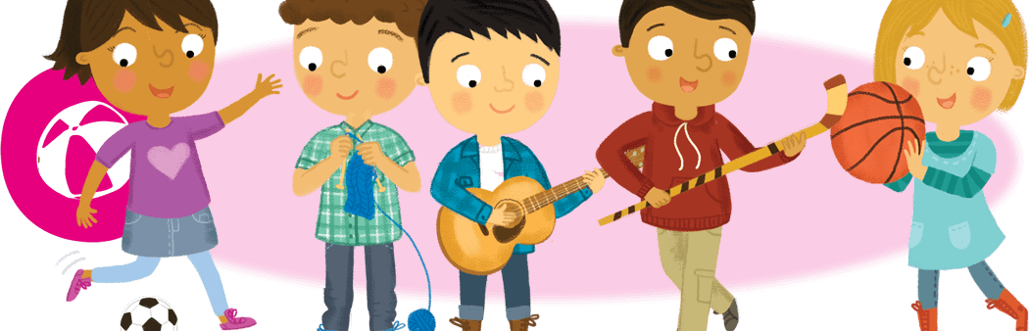
Hobbies and Free Time
Lesson 1: Listening

Slide 2
Notes for the Educator
This lesson is pegged directly to Learning Outcome LS 5.2 I can understand audio-visual texts across a range of genres, identifying the main idea and specific information.
It also targets other language outcomes such as: LS 5.8 I can communicate my own experiences, likes and dislikes fluently and accurately with some allowance to self-correct in the process.
The material for this lesson was adapted from Oxford Get Ready for Starters, 2nd edition (2017).
Teachers are to refer to the Scheme of Work where each lesson is explained in more detail.
Effects are included to make the presentation more interactive. Please present the PowerPoint in Slideshow mode.
Wherever possible we have included the use of online apps to enhance the teaching and learning experience.
The Notes section underneath the slides may contain some further points which can be developed during the lesson.
Teachers are encouraged to adapt this PowerPoint presentation to meet the learners’ language needs.
Tasks included in the PowerPoint presentation are also being shared as worksheets.
For any comments, feedback or suggestions please email us at: marie-claire.camilleri@ilearn.edu.mt; urieth.attard@ilearn.edu.mt; and mary.jude.camilleri@ilearn.edu.mt. You may also call the office on: 25983683.

Slide 3
Listen to some children talking about their hobbies.
Read a table and read posters about after school activities.
Respond to a story about an interesting hobby.
Talk about what hobbies we do during the week and how often.
Fill in a feedback form for a Kids Summer Club.

Slide 4
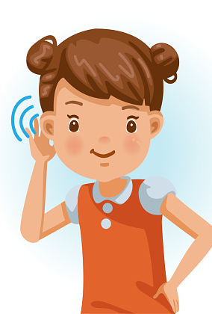
I am learning how to listen and respond to an audio-text.
I can understand what the main idea is.
I can listen to specific details and keywords.
I am able to complete the tasks.

Slide 5
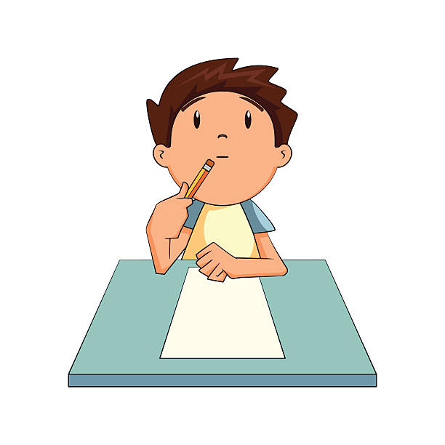
Think of your own hobbies. What do you like to do in your free time? Make a list.

Slide 6
doing
stories
painting and drawing
pictures
playing
in the sea
flying
to music
singing
a kite
making
sport
listening
the guitar
reading
cakes
swimming
songs

Slide 7
doing
stories
painting and drawing
pictures
playing
in the sea
flying
to music
singing
a kite
making
sport
listening
the guitar
reading
cakes
swimming
songs

Slide 8
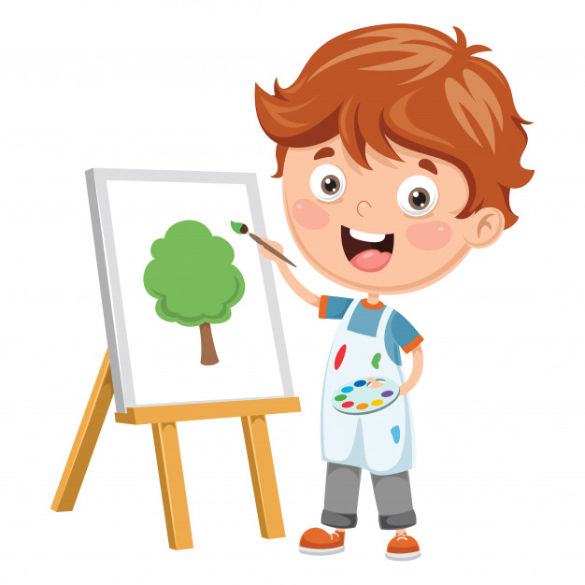
doing
stories
painting and drawing
pictures
playing
in the sea
flying
to music
singing
a kite
making
sport
listening
the guitar
reading
cakes
swimming
songs

Slide 9
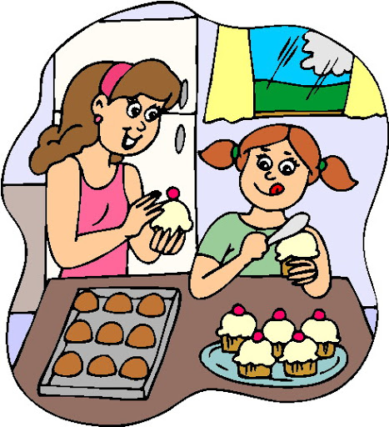
doing
stories
painting and drawing
pictures
playing
in the sea
flying
to music
singing
a kite
making
sport
listening
the guitar
reading
cakes
swimming
songs

Slide 10
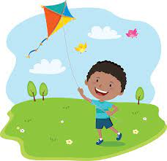
doing
stories
painting and drawing
pictures
playing
in the sea
flying
to music
singing
a kite
making
sport
listening
the guitar
reading
cakes
swimming
songs

Slide 11
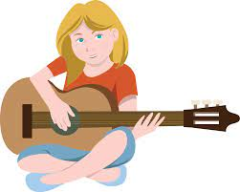
doing
stories
painting and drawing
pictures
playing
in the sea
flying
to music
singing
a kite
making
sport
listening
the guitar
reading
cakes
swimming
songs

Slide 12
doing
stories
painting and drawing
pictures
playing
in the sea
flying
to music
singing
a kite
making
sport
listening
the guitar
reading
cakes
swimming
songs

Slide 13
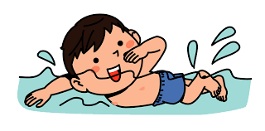
doing
stories
painting and drawing
pictures
playing
in the sea
flying
to music
singing
a kite
making
sport
listening
the guitar
reading
cakes
swimming
songs

Slide 14
doing
stories
painting and drawing
pictures
playing
in the sea
flying
to music
singing
a kite
making
sport
listening
the guitar
reading
cakes
swimming
songs

Slide 15
1st Listening Task:
What does each person like doing?
Notes:
In this lesson, we will be hearing two children talking about their hobbies. The first child is Sam. He talks about his favourite hobby and also about the hobbies of his friend and his sisters Jill and Kim.

Slide 16
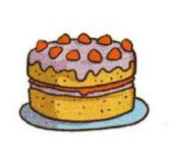
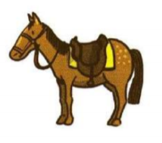
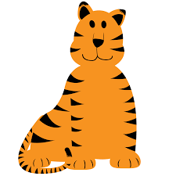
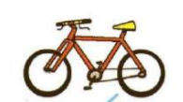
1a. What does Sam like doing? Tick two.
Sam likes

Slide 17
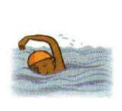
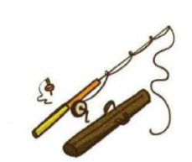
1b. What does Nick like doing? Tick two.
Nick likes

Slide 18
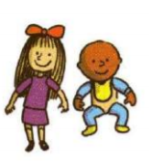
1c. What does Jill like doing? Tick two.
Jill likes

Slide 19
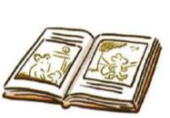
1d. What does Kim like? Tick two.
Kim likes

Slide 20
2nd Listening Task:
Listen carefully. Answer True or False.

Slide 21
Task 2: Are these sentences True or False?
 |  | True | False
a. | Sam likes riding his scooter.
b. | Nick has a small horse.
c. | Sam has two sisters.
d. | Jill likes learning English.
e. | Kim likes making biscuits.
f. | Kim has only one doll.
g. | Sam says his toy tiger is great.

Slide 22
3rd Listening Task:
Listen carefully. Answer True or False.

Slide 23
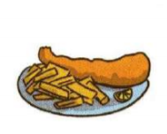
Task 3.a. Circle the correct picture.
Lucy doesn’t like eating

Slide 24
Task 3.b. Circle the correct picture.
Lucy likes eating

Slide 25
Task 3.c. Circle the correct picture.
What does Lucy like to read?

Slide 26
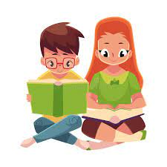
Task 3.d. Circle the correct picture.
At home, she reads books with her

Slide 27
Task 3.e. Circle the correct picture.
Tom enjoys

Slide 28
Task 3.f. Circle the correct picture.
Which of these foods do Lucy and Tom both like to eat?

Slide 29
What do the members of your family like doing in their free time?
Dad
play football
Mum
brother
What do you do in your free time?
sister
What are your hobbies?
Nanna Rita

Slide 30
Thank you for using this resource. Check out our latest resources below.

