Slide 1
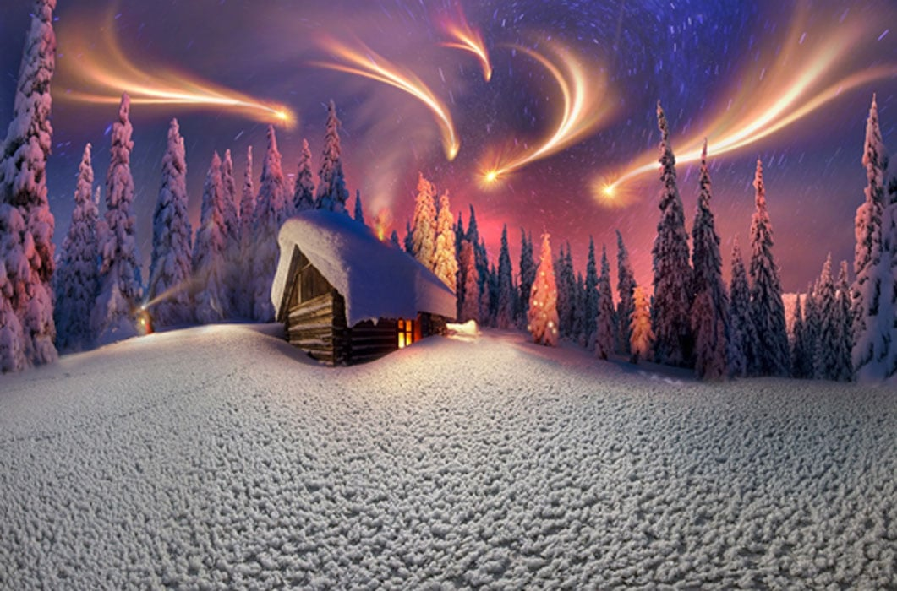
Myths and Legends
Lesson 4 - Speaking

Slide 2
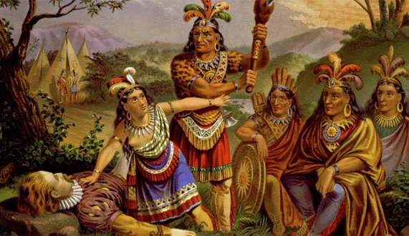
I’m guessing this legend is from…because…
I wonder if…
I think that…

Slide 3
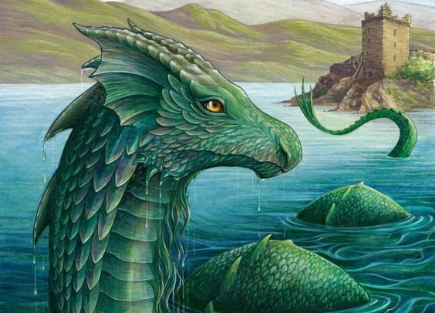
What is this?
What is the setting?
Where is this legend set?
What is this legend about?

Slide 4
I see…
I wonder….
I think…

Slide 5
How would you feel if you were on the scene?
What catches your attention in this picture?
What do you think about the colour choices in this illustration?

Slide 6
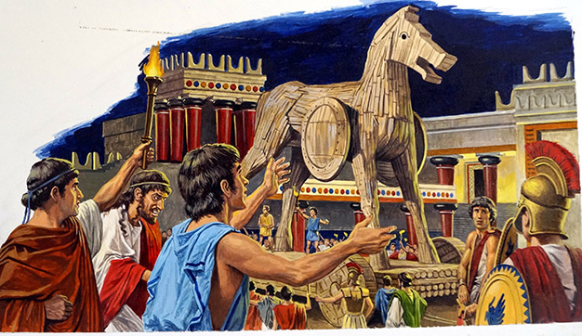
What are these people thinking?

Slide 7
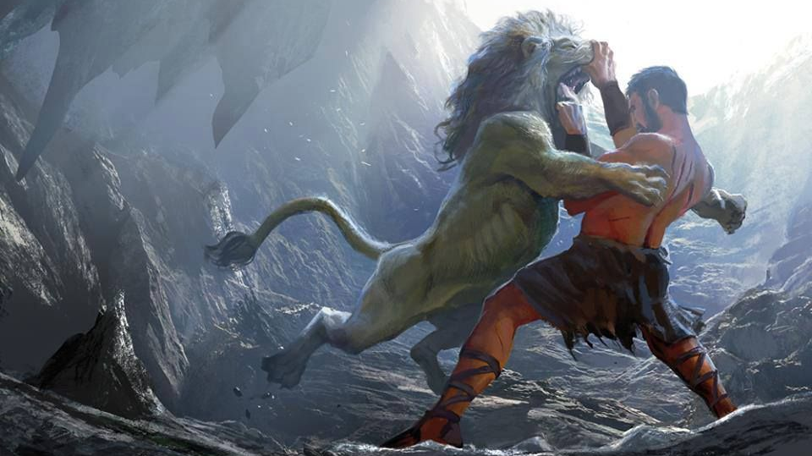
Say what is happening using the present continuous.

Slide 8
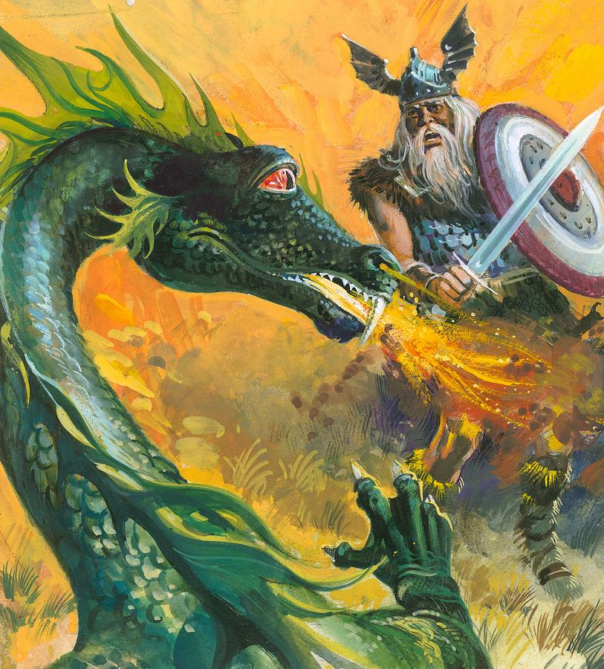
Think-Pair-Share.
Come up with three observations about this picture.

Slide 10
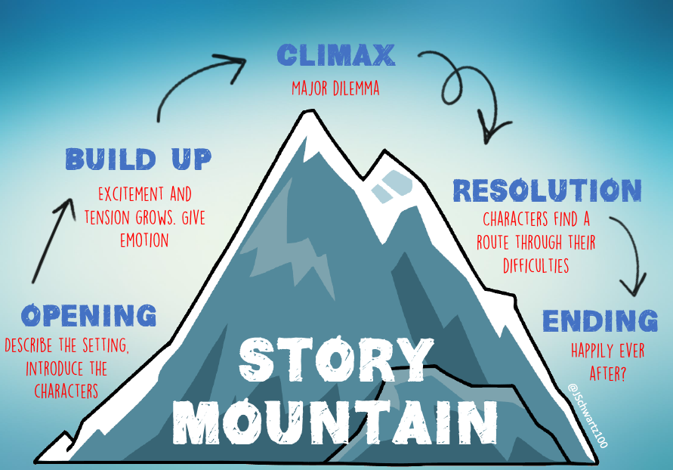
The structure of a traditional tale or legend usually goes like this:
Let’s put this structure to the test with our story ‘Grandmother Spider steals the Sun’.

Slide 11
Opening: The story begins with a traditional opener. The scene is set, and the problem introduced.
When the Earth was first made, there was only blackness, and nobody could see anything. People said: “What this world needs is light.”
“I have heard there is something called the Sun,” said the Bear. “It is kept on the other side of the world, but the people there will not share it. Perhaps we can steal a piece of it.” All the animals agreed that it was a good idea. But who would be the one to steal the Sun?
The fox was the first to try. He sneaked to the place where the Sun was kept. He waited until no one was looking. Then he grabbed a piece of it in his mouth and ran. But the Sun was so hot it burned his mouth and he dropped it. To this day all foxes have black mouths because that first fox burned his carrying the Sun.
The possum tried next. “I have a beautiful, bushy tail,” he boasted. “I can hide the light inside all that fur.” Possum set out for the other side of the world. There he found the sun hanging in a tree and lighting everything up. He sneaked over to the sun, picked out a tiny piece of light, and stuffed it into his tail. But the light was hot and burned all the fur off. Ever since, Possum’s tail has been bald.
“I’ll try,” said Buzzard. “I know better than to hide a piece of stolen light in my tail. I’ll place it on my head.” He flew off and swooped straight into the sun, seizing it with his claws. He then placed it on his head, where it proceeded to burn all his head feathers off. And ever since that time Buzzard’s head has remained bald.
Finally, Grandmother Spider said, “Let me try!” First, she made a thick-walled clay pot. Next, she spun a web reaching to the other side of the web. Because she was so small, nobody noticed her coming. Quickly Grandmother Spider scooped up the sun in her pot and scrambled back home along one of the strong strands of her web. Now her side of the world had light, and everyone rejoiced.
Grandmother Spider brought not only the sun to the Cherokee, but fire as well. And, she taught the Cherokee people the art of pottery making.
Characters are introduced. Dialogue makes the story interesting and more realistic . It helps move the plot along when we tell the story.
Build-up: The action moves forward and there is a happening from an imaginary world.
Problem: The problem gets more complicated and there is a conclusion to the Fox’s behaviour.
There is repetition of the problem.
Adjectives and verbs are used purposefully to describe characters’ features and behaviour.
Resolution: We are moving towards a resolution to the problem. Connectors move the story along.
Using lots of verbs close together gives the sense of speed and action.
Ending: The problem is resolved and with an extra twist.

Slide 13
Opening
Traditional opener - create a setting in the distant past.
Describe your setting – where does your story start?
Introduce the problem / dilemma.
Introduce the characters.

Slide 14
Many years ago...
In Roman times...
There was a time long ago, when...
Long, long, ago...
There was once...
Before the world was formed...
A long time ago, in...
In the middle of nowhere…
On top of the tallest mountain...
Long ago, in the ancient Greek city of...
Between the sea and the sky...

Slide 15
Build-up
Events leading up to the main problem or conflict.
What things happen?
What clues are there?
What is said?
How is excitement built?

Slide 16
As time went on…
eventually...
As evening approached...
The next day...
Soon after...
It wasn’t long before...
While...
Just then...
Meanwhile…
Later that day...
Several months later...

Slide 17
Dilemma
Things are going wrong!
Is there a mystery? Do terrible things happen?
Are there any disagreements?

Slide 18
Suddenly…
From the shadows...
Quickly...
Feeling rather poorly...
Out of the blue...
In a heart stopping moment...
without hesitation...
Flying into a jealous rage...

Slide 19
The Resolution
Problems need to be solved so that characters are happy again.
How are things going to be sorted out?

Slide 20
Heart beating…
cautiously...
As quick as a flash...
unexpectedly...
Fortunately...
Before very long...
Luckily...
couldn’t believe what he/she was seeing…
As swift as an eagle...
Without warning...

Slide 21
The Ending
Does the story end with a happily ever after?
What have the characters learned?
Have the characters changed?

Slide 22
At last…
At the end...
At long last...
Finally...
From that time on...
From that day on...
Smiling happily...
When all was said and done…
Miraculously...
And that was the end of the…

