Slide 1
Lesson 5 Writing
Year 5
English

Slide 2
Lesson 5 Objectives
You will:
learn how to give directions in writing.
learn what are the success criteria for giving directions.
learn what are the success criteria for writing a short message.

Slide 3
Lesson Resources
Title of message and map
Writing Frame Handout
Success Criteria Handout

Slide 4
Title
Your cousin Dan, is moving to your village and will start attending your school.
Write him a message, to give him directions on how to get to his new school.

Slide 5
Pay attention!
Genre:
A MESSAGE
Audience:
COUSIN DAN
Purpose:
TO GIVE DIRECTIONS
GAP
G: GENRE
A: AUDIENCE
P: PURPOSE

Slide 6
What is a message?
A message is written to a person you know well such as a close relative or your friend. It is kept concise and to the point.
Messages can be written for different reasons and purposes such as to apologise, to thank someone, to inform or to give instructions.

Slide 7
How to write directions!
When writing directions, use the imperative mood and follow the correct sequence. Sentences should be brief, specific and include one direction.
Directions can be in point form or in a paragraph.

Slide 8
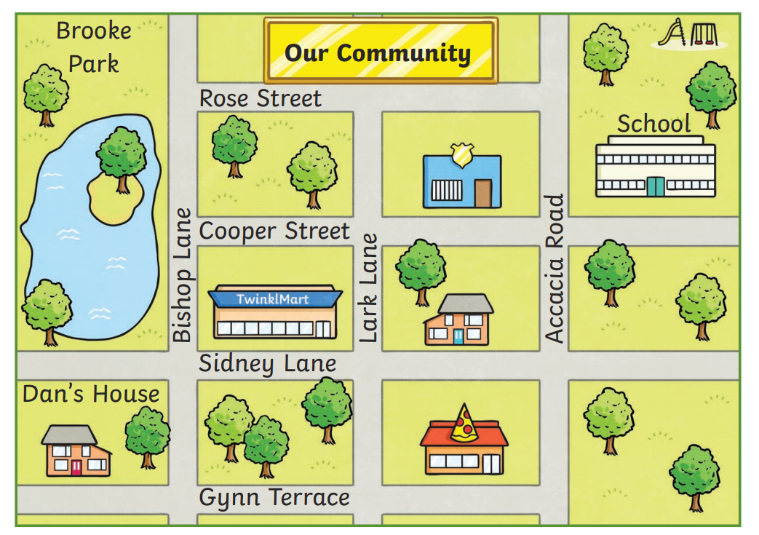

Slide 9
Features of a message
The message, is clear and to the point.
A salutation followed by a comma (e.g. Dear Jack,), is in the left-hand corner.
A paragraph which starts with a greeting, followed by the contents of the message and a concluding sentence where you ask the receiver to write back.
A closure followed by a comma (e.g. Yours, Love, …), is in the middle of the page.
The signature is under the closure.
INDENT YOUR PARAGRAPH.
SKIP A LINE BETWEEN THE SALUTATION, THE PARAGRAPH AND THE CLOSURE.
SKIP TWO LINES BETWEEN THE CLOSURE AND THE SIGNATURE.

Slide 10
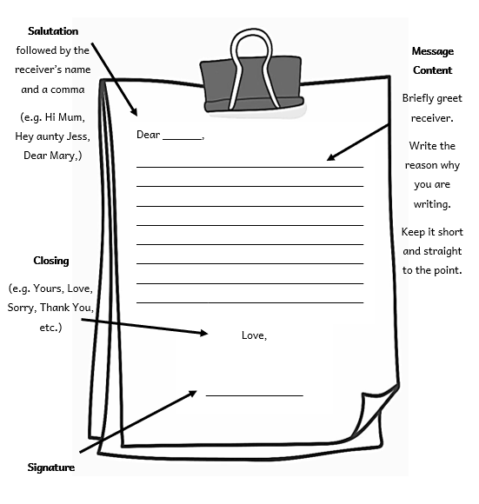

Slide 11
How to write directions in a message
The directions, are clear and to the point.
The directions are written in the form of a paragraph and follow a logical sequence.
Connectives such as first, next and then are used.
The imperative mood (e.g. Turn…, Drive …, ) is used.

Slide 12
Go straight

Slide 13
Turn right

Slide 14
Turn left

Slide 15
Take the first street on the right.

Slide 16
Take the second street on the left.

Slide 17
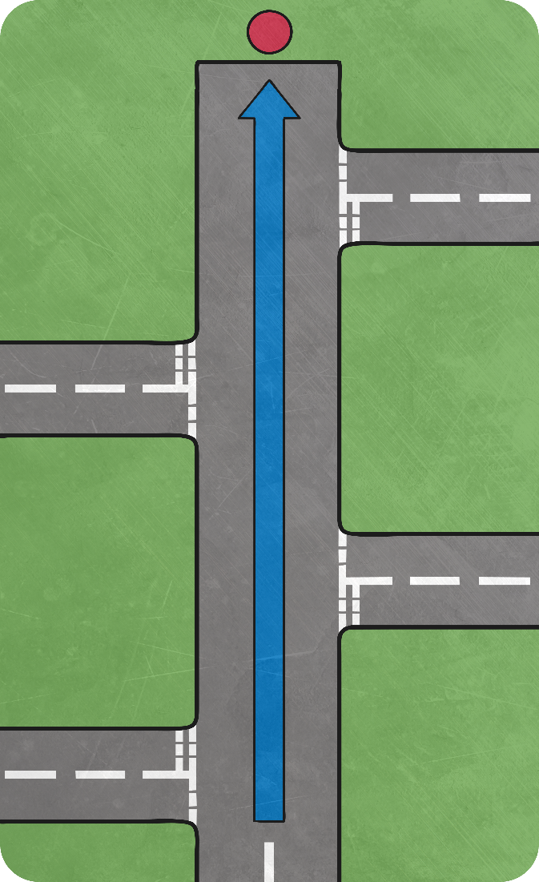
It is at the end of the street.

Slide 18
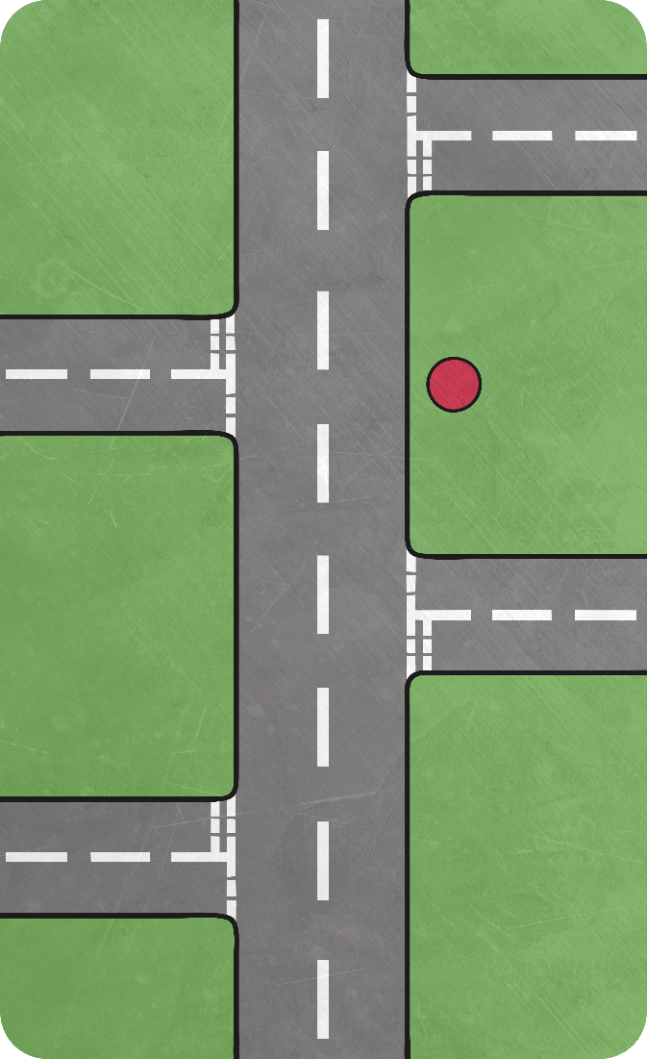
It is on the right.

Slide 19
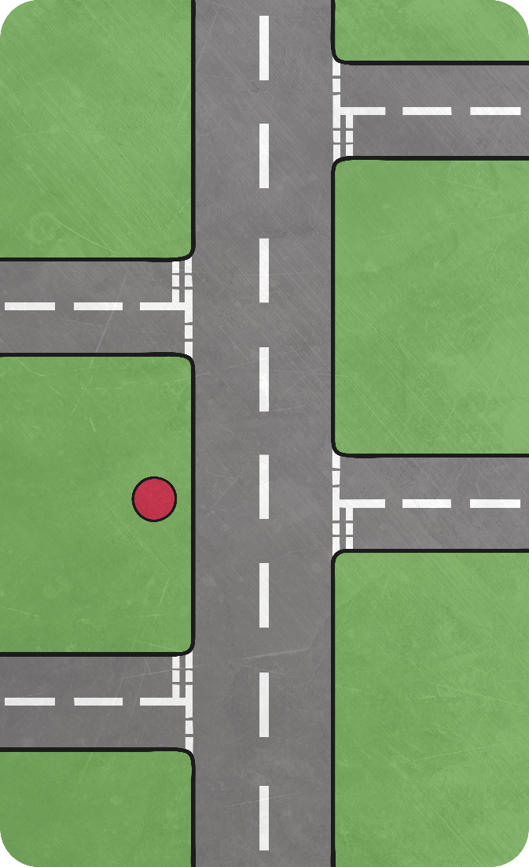
It is on the left.

Slide 20
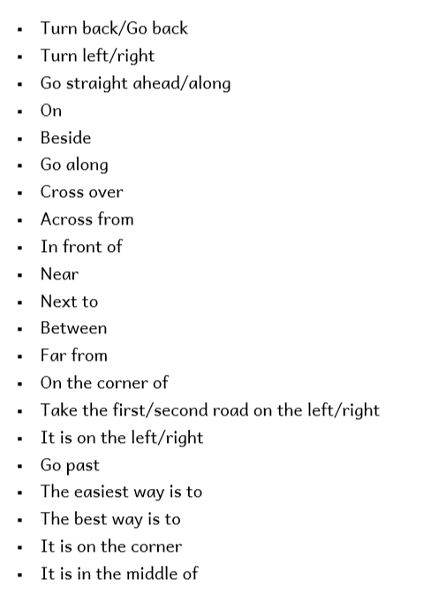
Word Mat

Slide 22
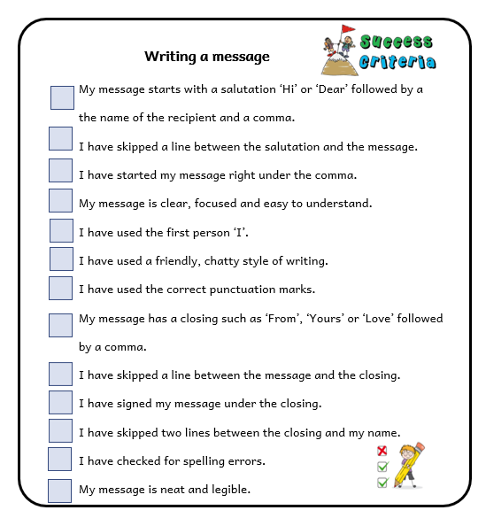
Success Criteria!
What are success criteria?
Success criteria are a list of steps you have to follow or a list of features you are to include in your task. They will make you aware of what is expected and help you self-assess your work.

Slide 23
Success Criteria!
What are success criteria?
Success criteria are a list of steps you have to follow or a list of features you are to include in your task. They will make you aware of what is expected and help you self-assess your work.

Slide 24
Thank You!

