Slide 1
Lesson 3: Speaking Topic: Hobbies and Leisure Year: 4

Slide 2
PART 1
Information Gap Activity

Slide 3
Lesson OBJECTIVE:
I will learn:
how to ask and answer questions to gain information.

Slide 4
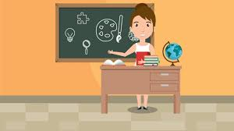
Download these resources:
Table 1 Handout
Table 2 Handout

Slide 5
WATCH the following video clip.
What is the video clip about?

Slide 7
What is the video clip about?
The video clip shows different types of hobbies. Some hobbies mentioned are jogging, skateboarding, swimming, basketball, watching soccer matches, hiking and camping, playing the piano and riding a horse.

Slide 8
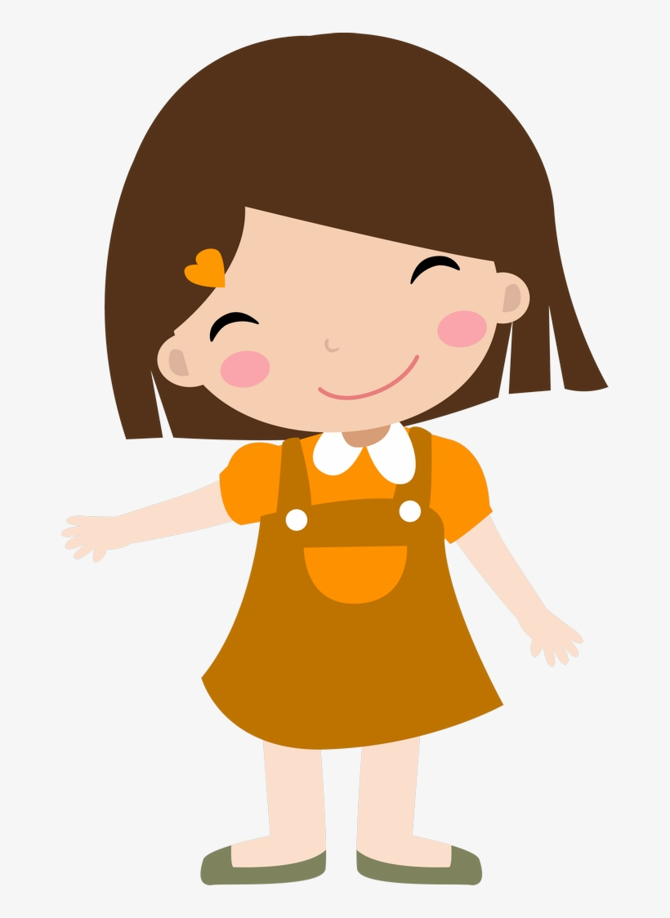
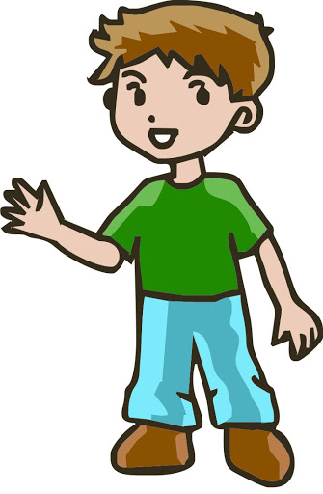
ACTIVITY
SAM
JENNY
PAUL

Slide 9
Activity: Person A - Table 1 Handout

Slide 10
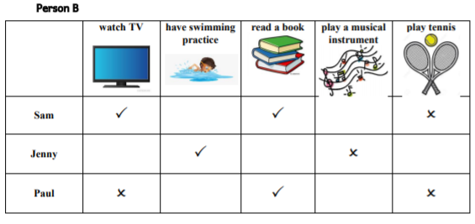
Activity: Person B – Table 2 Handout

Slide 11
Ask a friend or relative to participate in this activity. One of you will have a copy of Table 1 and the other a copy of Table 2.
Ask each other questions to find out the missing information.

Slide 12
Question Models and Model Answers
Person A: Does Sam watch TV after school?
Person B: Yes, he does.
Person B: Does Sam have swimming practice after school?
Person A: No, he doesn’t.

Slide 13
Another example:
Person A: Does Paul read books after school?
Person B: Yes, he does.
Person A: Does he play a musical instrument after school?
Person B: Yes, he does.

Slide 14
PART 2
Compare and Contrast
2 Pictures

Slide 15
Download these resources:
Pictures Handout
Useful Keywords and Phrases
Handout
Sentence Starters Handout
‘Find someone who’ worksheet

Slide 16
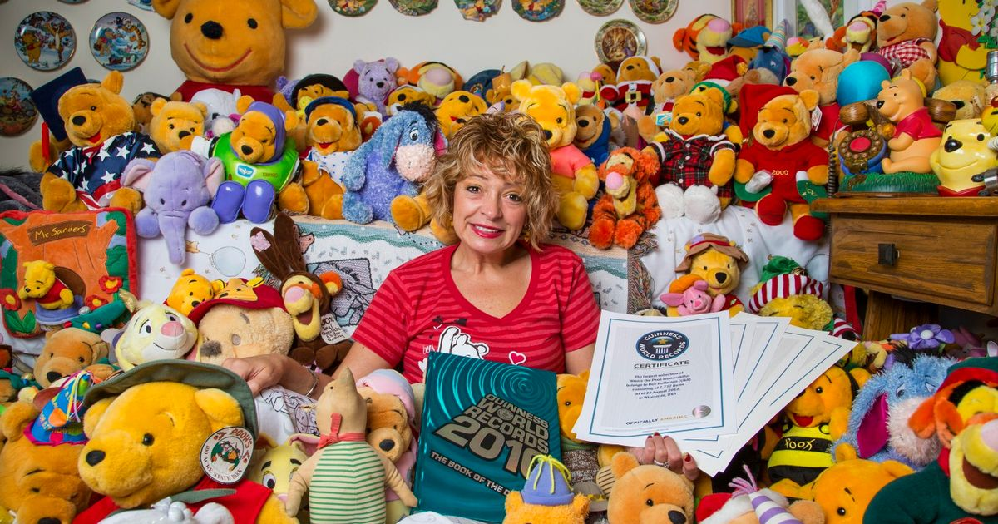

Slide 17
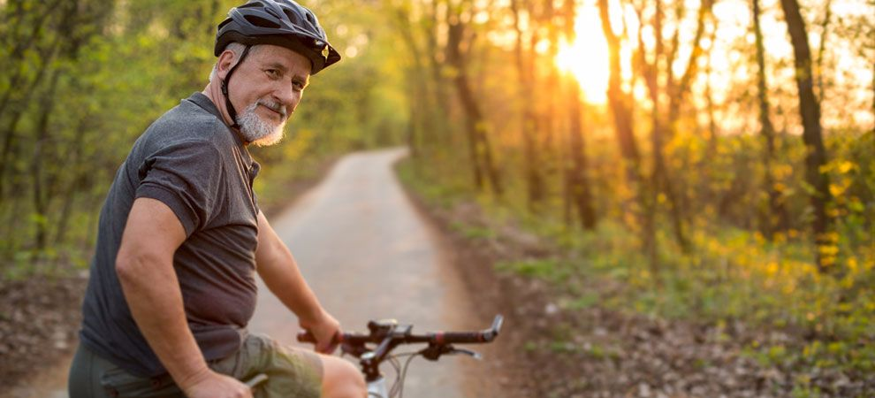

Slide 18
Useful keywords and phrases:
number of persons
physical description
expression on their face/s, age, clothes, place
activities they are doing
weather

Slide 19
COMPARE and CONTRAST the two pictures.

Slide 20
Look at the two pictures.
How are the two pictures similar?
How are the two pictures different?
Which is your favourite picture? Why?

Slide 21
Post- Activity:
Download the ‘Find someone who …’ worksheet.
Ask a friend or relative the questions on the worksheet. If they like doing the activity listed in the box, write down their name.
Try to fill in every single box!

Slide 22
A. Hello Uncle ... Do you like cooking?
B. Not really. Aunt … is a better cook than me.
Ok. Do you like going to the gym?
Yes, I do. I go twice a week to the gym.
A. Hello … Do you like photography?
B. Not at all.
What about surfing the Internet?
I like that a lot. I spend hours surfing the Internet.

Slide 23
A. Hello Aunty ... Do you like dancing?
B. Yes. In fact, I am part of the local folk-dance group.
Really? How long have you been practising folk dance?
It’s been over five years now!
A. Hello ... Do you like sleeping?
B. Who doesn’t? My parents call me a sleepy head.
What about writing at school?
I like writing. I am very good at writing creative stories.

